Slide 1

Reducing Vaccination Pain & Anxiety in Children
Sharon G. Humiston, MD, MPH
Director for Research
Immunize.org
Eddie Lyon, DO
IKC Board Member, At-Large Position
https://team.childrensmercy.org/EdwardLyonDO/1083119077

Slide 2





Continuing Education Accreditation
Reducing Vaccination Pain & Anxiety in Children
Joint Accreditation Statement
Pharmacist Accreditation Statement
In support of improving patient care, this activity has been planned and implemented by PRIME Education (PRIME®) and Immunize Kansas Coalition. PRIME® is jointly accredited by the Accreditation Council for Continuing Medical Education (ACCME), the Accreditation Council for Pharmacy Education (ACPE), and the American Nurses Credentialing Center (ANCC) to provide continuing education for the healthcare team.
This Knowledge-based activity has been approved for 0.5 contact hour (0 CEUs) by PRIME® for pharmacists. The Universal Activity Number for this activity is JA0007144-9999-26-346-L06-P. Pharmacy CE credits can be submitted to the NABP upon successful completion of the activity by providing your NABP ID & DOB, which must be submitted within 60 days of completion. Pharmacists with questions can contact NABP customer service (help@nabp.pharmacy).
Physician Credit Designation Statement
PRIME® designates this Live activity for a maximum of 0.5 AMA PRA Category 1 Credits™. Physicians should claim only credit commensurate with the extent of their participation in the activity.
Nurse Accreditation Statement
PRIME® designates this activity for 0.5 contact hour.
Physician Associate Accreditation Statement
PRIME® has been authorized by the American Academy of PAs (AAPA) to award AAPA Category 1 CME credit for activities planned in accordance with AAPA CME Criteria. This activity is designated for 0.5 AAPA Category 1 CME credit. Approval is valid until . PAs should only claim credit commensurate with the extent of their participation.
1

Slide 3
PRIME® Policies
Mitigating Conflicts of Interest
PRIME Education, LLC (PRIME®) adheres to the ACCME‘s Standards of Integrity and Independence in Accredited Continuing Education, in compliance with Joint Accreditation. These Standards require everyone in a position of controlling the content of a CE activity to disclose all financial relationships with ineligible companies. CE activities must offer fair and balanced content, remain independent of commercial bias, and designed to improve quality in health care. All recommendations involving clinical medicine must be based on evidence accepted within the medical profession.
A conflict of interest arises when individuals in a position of controlling the content of CE activities have a relevant financial relationship with an ineligible company that may bias his/her opinion and teaching. This may include receiving a salary, royalty, intellectual property rights, consulting fee, honoraria, stocks, or other financial benefits.
PRIME® has identified, reviewed, and mitigated all conflicts of interest that speakers, authors, course directors, planners, peer reviewers, or relevant staff disclose prior to the delivery of any educational activity. Disclosure of a relationship is not intended to suggest or condone bias in any presentation but is made to provide participants with information that might be of potential importance to their evaluation of a presentation. Disclosure information for speakers, authors, course directors, planners, peer reviewers, and/or relevant staff is included in these materials.
Unapproved Uses
Presentations may provide information in whole or in part related to non-FDA-approved uses of drugs and/or devices or may discuss the unlabeled indications or the investigational nature of their proposed uses. Participants should refer to the official prescribing information for each product for discussion of approved indications, contraindications, and warnings. Participants should verify all information and data before treating patients or employing any therapies described in this educational activity.
Disclaimer
The opinions expressed in the educational activity are those of the presenting faculty and do not necessarily represent the views of PRIME®, Joint Accreditation (ACCME, AAPA, ACPE, ANCC, ARBO COPE, APA, ADA), AAPA or other relevant accreditation bodies.
Questions?
Please email accreditation@primeinc.org.

Slide 4
Disclosures
There is no commercial or in-kind support for this activity.
*PRIME® has identified, reviewed, and mitigated all relevant financial relationships that speakers, authors, course directors, planners, peer reviewers, or relevant staff disclose prior to the delivery of any educational activity.
The following individuals have identified relevant financial relationships with ineligible companies to disclose:
Sharon Humiston, MD, MPH (Course Director)
Speakers Bureau or other Promotional Education – Merck Vaccine Division, Sanofi Pasteur
The relationships reported above are related to the following therapeutic area: Vaccines
Kristi Kay Orbaugh, RN, MSN, RNP, AOCN (Planner)
Speakers Bureau or other Promotional Education – AstraZeneca, Bristol-Myers Squibb, DSI, Exilixis, Gilead Sciences, Pfizer, Stemline
The relationships reported above are related to the following therapeutic area: Oncology
The following individuals have no relevant financial relationships with ineligible companies to disclose:
Eddie Lyon, DO (Moderator)
Abimbola Farinde, PhD, PharmD (Planner)
Annette Sophin, MSMM, PA-C (Reviewer)
All PRIME® staff participating in planning and content development have no relevant financial relationships with ineligible companies to disclose.

Slide 5
Obtaining CE Credit
Obtaining CE Credit
Register using the online form
Complete the pre-registration survey
Attend the live program in its entirety
Complete an online evaluation and/or post-test
Download and/or print a certificate of completion and/or submit CE credits electronically
Method of Participation
Specific instructions to access CME/CE credit options will be provided at the end of the program.
This live CME/CE activity requires attendance during the entire program and completion of learner assessment tools. The learner will then receive instructions on how to download and/or print a certificate of completion and/or submit CE credits electronically.
2

Slide 6
Objectives: Regarding the management of pain and anxiety for children undergoing a vaccination visit, the learner will be able to:
Summarize the importance of this topic in 1-3 sentences
Design a 10-minute in-service for other clinicians in their practice regarding interventions that are evidence-based and feasible to implement in their setting
Appraise online resources to guide parents and clinicians who want to improve the child’s vaccination experience

Slide 7
Introductory notes
Continuing education credits
There are related modules on the IKC website
Shorthand (e.g., “parents,” vaccination = immunization)

Slide 8
Outline of today’s 30-minute webinar
The problem
Assessing pain & anxiety
A word on syncope
How families can prep
What healthcare professionals can do
Resources

Slide 9
Background
Pain
  Personal, individual
  Influenced by emotions, coping mechanisms, history, culture, age
  “Shame never made anyone less pained.”
Anxiety
"an abnormal and overwhelming sense of apprehension and fear often marked by physical signs ..., by doubt concerning the reality and nature of the threat, and by self-doubt about one's capacity to cope with it."

Slide 10
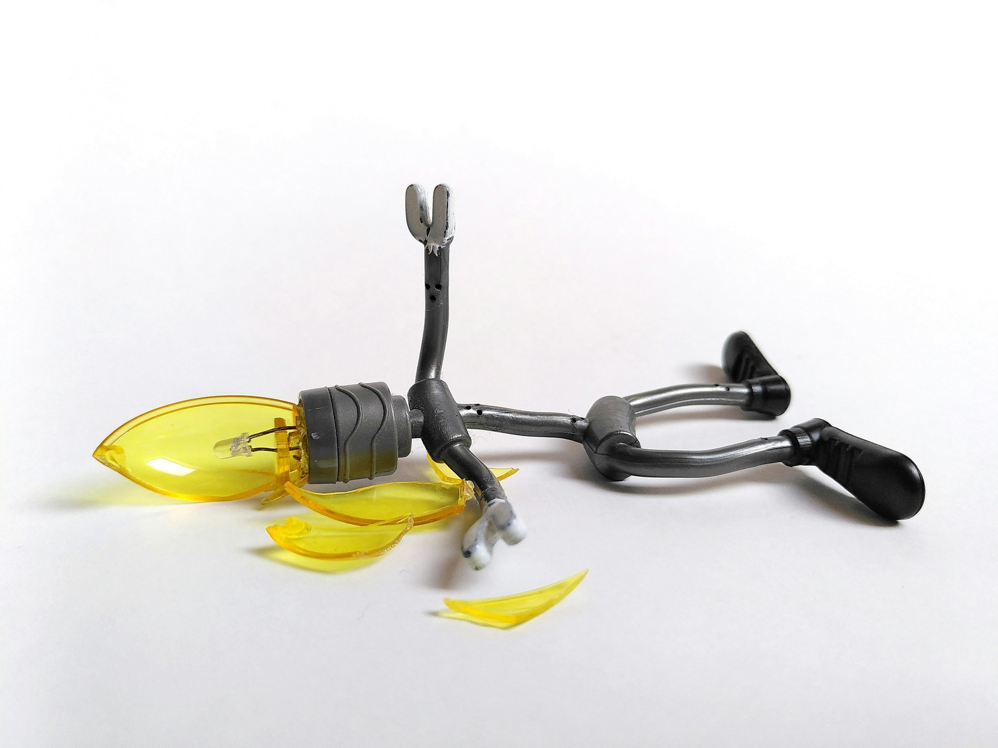
Importance
Important to the person experiencing pain, anxiety
Can influence a person's decisions regarding current and future healthcare, including vaccinations (avoidance, refusal)
Exhausting for healthcare personnel

Slide 11

World Health Organization guidance
https://www.who.int/publications/i/item/9789241515948

Slide 12
Let’s play “Test the Moderator!” True or False?
Based on a Canadian survey on fear of needles…
Almost 2/3 of children
10% of parents
Needle fear was the primary reason for immunization non-compliance for 7% and 8% of parents and children, respectively.
https://www.sciencedirect.com/science/article/abs/pii/S0264410X1200686X
Notes:
A Canadian survey found fear of needles to be very common:
63% of children
24% of parents
Needle fear was the primary reason for immunization non-compliance for 7% and 8% of parents and children, respectively.

Slide 13
Outline of today’s 30-minute webinar
The problem
Assessing pain & anxiety
A word on syncope
How families can prep
What healthcare professionals can do
Resources

Slide 14

Assessment
No direct measurement, many scales (often very specific) –
Vaccination discomfort Scale (VACS)
Informal evaluation

Slide 15
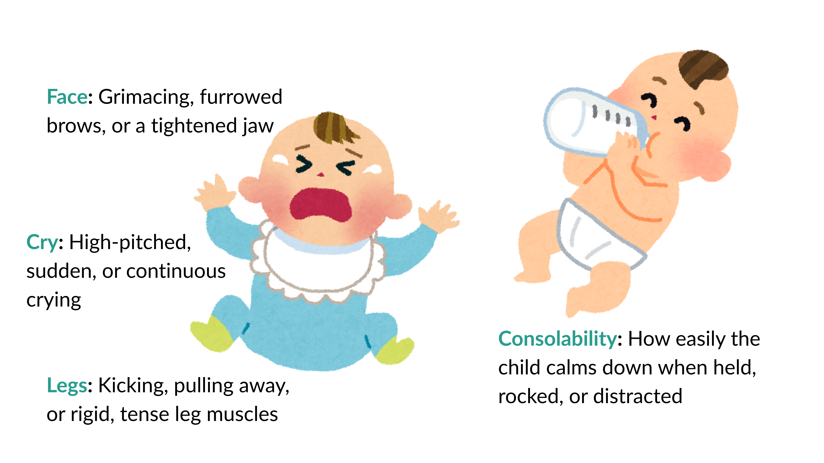

Slide 16
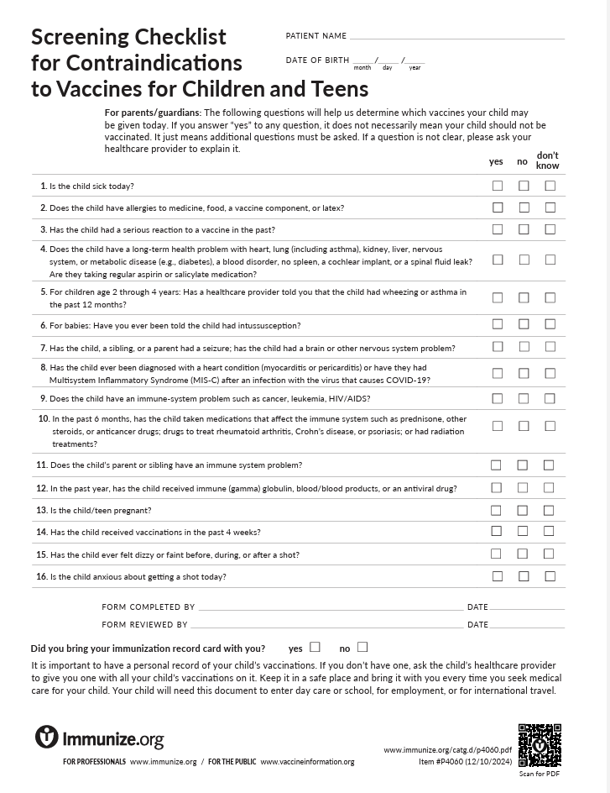
Self-report to assess & manage pain
Especially important to optimize vaccination experience of someone with known vaccination-related anxiety
For older children and adolescents, we can often rely on patients' self-reports
Optimal results can be obtained if:
  Patients can describe their pain to healthcare personnel AND
  Healthcare providers can listen and plan around the stated needs
www.immunize.org/wp-content/uploads/catg.d/p4060.pdf

Slide 17
Outline of today’s 30-minute webinar
The problem
Assessing pain & anxiety
A word on syncope
How families can prep
What healthcare professionals can do
Resources

Slide 18

Vaccination-related syncope
Fainting (syncope), a brief loss of consciousness caused by a decreased blood flow to the brain, is usually triggered by pain or anxiety.
While syncope itself is not worrisome, there are
2 concerning potential consequences:
  Some people who fainted after vaccination
  have fallen and injured themselves
  Muscle twitching may occur during syncope,
  and this may be misinterpreted as a seizure

Slide 19

Preventing vaccination-related syncope
Ask about history, what they do to prevent fainting.
Ask how they prefer to handle their anxiety and
support their choices.
Make suggestions, if needed; slow, deep breaths, or distractions (by a mobile device or conversation) may help.
Keep wait times to a minimum.
Keep needles out of view until necessary.
Offer techniques to reduce pain as feasible.
Address hunger or thirst, which may increase risk of syncope.

Slide 20
Let’s play “Test the Moderator!” TRUE or FALSE?
Fainting is an adverse reaction to a specific vaccine ingredient, so it’s a contraindication to all future use of that vaccine.
The incidence of syncope is higher in young children than in any other age group.
Notes:
Fainting is related to the act of injection and is not an adverse reaction to a specific vaccine ingredient. It is not a contraindication or a a precaution to the administration of any vaccine.
The incidence of syncope is higher in adolescents or young adults than in young children, but syncope can occur at any age.

Slide 21
Outline of today’s 30-minute webinar
The problem
Assessing pain & anxiety
A word on syncope
How families can prep
What healthcare professionals can do
Resources

Slide 22
What families can do before the visit
Preview the visit with the child
Bring supportive items
Topical analgesia
(Acetaminophen, ibuprofen not helpful with injection pain)

Slide 23

Preview the visit
Social Story from Autism Society (The first two pages are shown)
https://autismsociety.org/wp-content/uploads/2023/09/2023_Autism-Society_Getting-My-Vaccine_Social-Story_English.pdf

Slide 24

Bring supportive items

Slide 25
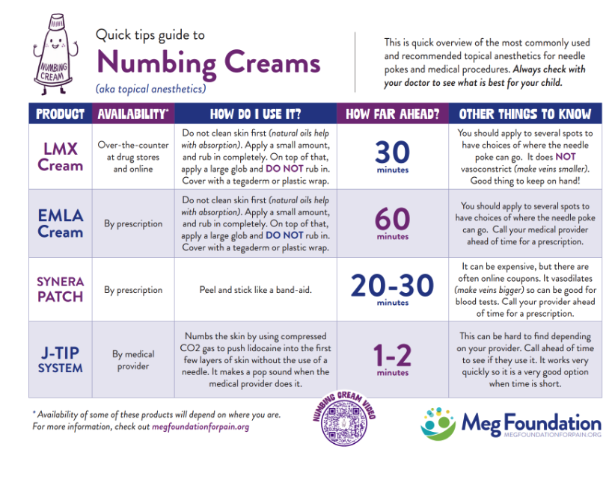
Topical analgesia
https://www.megfoundationforpain.org/topical-anesthetics-infographic/

Slide 26
Topical analgesia downsides
Correct site(s) 30-60 minutes before vaccination
Cost (not covered by insurance)
Allergic reaction
Can’t get into mouth or eyes
Some children have a sensory aversion to cream, gel

Slide 27
Outline of today’s 30-minute webinar
The problem
Assessing pain & anxiety
A word on syncope
How families can prep
What healthcare professionals can do
Resources

Slide 28
Easy + free = Routine
Keep needles out of sight until needed
Consider starting with vaccination
Vaccination technique (e.g., correct needle length, inject quickly, no aspiration)
Most painful vaccine last
Neutral language, calm actions (get parent buy-in)

Slide 29
Question for moderator:
Have you seen this parent behavior?
”I’m so sorry! I’m so sorry that you have to go through this!”
(Visible anxiety)
“Don’t worry! This is going to be fine! Don’t be scared!”
“This won’t hurt at all.”
“Suck it up, buttercup. Boys don’t cry.”

Slide 30
Easy + free = Routine
Keep needles out of sight until needed
Consider starting with vaccination
Vaccination technique (e.g., no aspiration)
Most painful vaccine last
Neutral language, calm actions (get parent buy-in)
Giving kids choices (Do you want to watch or do you like looking away?)
Distraction before, during, after injection – age appropriate
Comfort positioning by caregiver, upright (see CHOP web page)
For infants: Breast feeding during vaccination, sweet solutions shortly before

Slide 31
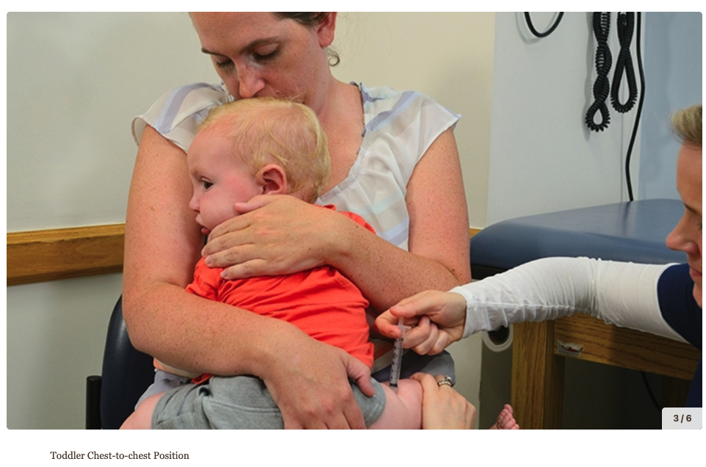
Comfort positioning
https://www.chop.edu/centers-programs/child-life-education-and-creative-arts-therapy/prepare-your-child-visit-doctor/comfort-positioning-during-procedures

Slide 32
Distraction for older children & adolescents
Videos, social media
Music
Deep breathing
Slow breathing exercises
Guided imagery
Counting games

Slide 33
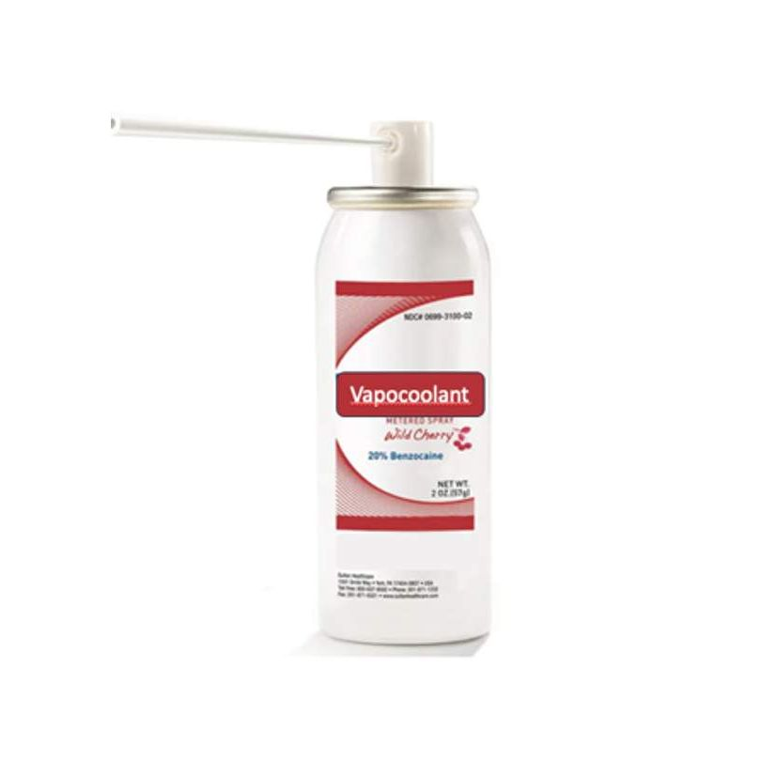
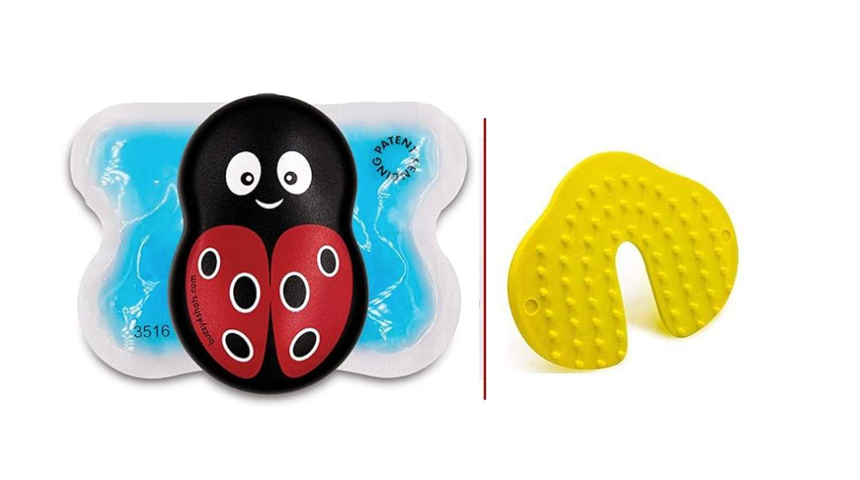
More advanced
Vapocoolant sprays, ice?
Devices – Buzzy, Shotblocker

Slide 34
Outline of today’s 30-minute webinar
The problem
Assessing pain & anxiety
A word on syncope
How families can prep
What healthcare professionals can do
Resources

Slide 35
Five Key Resources (links in the IKC online module)
The CARD System
Help Eliminate Pain in Kids & Adults (HELP in Kids & Adults)
Meg Foundation
Immunize.org
Children’s Hospital of Philadelphia (CHOP)

Slide 36
Wrap up
Vaccination-related pain & anxiety are an important problem for several reasons
Assessing pain & anxiety – informal methods usually suffice,
Prevent syncope, prevent syncope-related falls
Families can do things to prep: Social steps, supportive items, topical analgesia
What healthcare professionals can do
Resources!

Slide 37

x
x

Slide 38
Credit Center
  To receive credit, please visit
  www.primeinc.org/credit and enter program code.
  Looking for the code?
  Live webinar: If you registered for and attended the live webinar but did have time to write down the code, please reach out to staff@immunizekansascoalition.org for assistance.
  Recorded webinar: We plan to post a recording of the webinar soon and hope to offer continuing education as enduring material. It will have a different code. Watch the website for more information.

