Slide 1
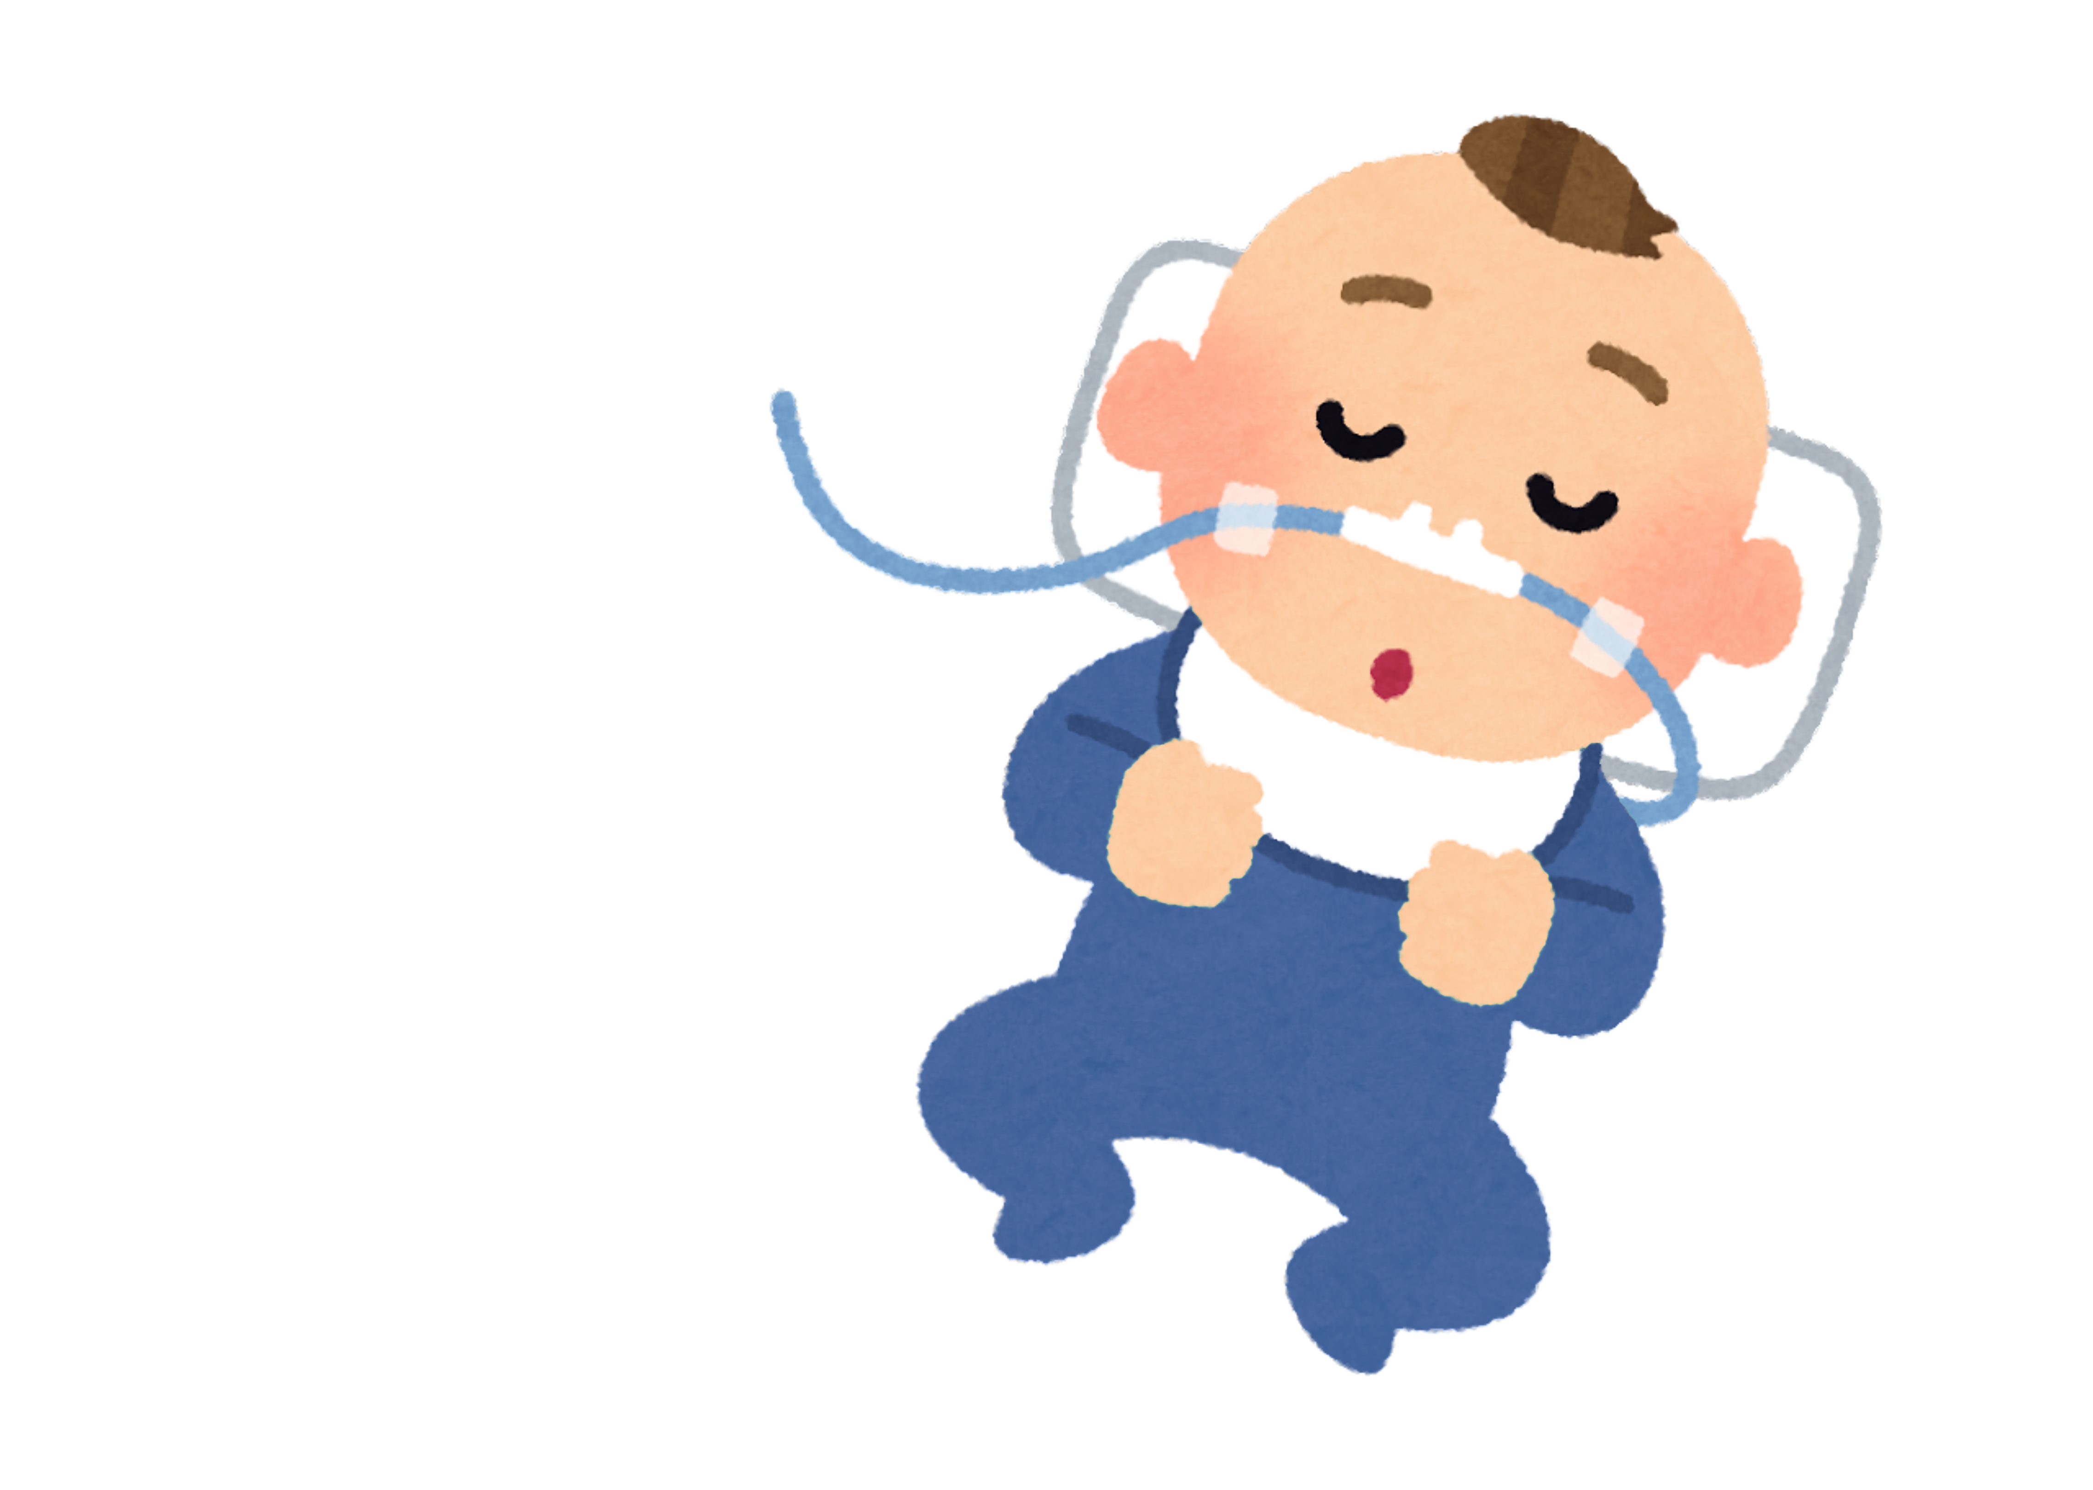
Preventing Infant RSV Disease
Sharon G. Humiston, MD, MPH
Director for Research
Immunize.org
Eddie Lyon, DO
IKC Board Member, At-Large Position

Slide 2
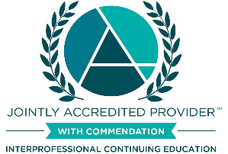




Continuing Education Accreditation
Preventing Severe RSV Disease in Infants
Joint Accreditation Statement
Pharmacist Accreditation Statement
In support of improving patient care, this activity has been planned and implemented by PRIME Education (PRIME®) and Immunize Kansas Coalition. PRIME® is jointly accredited by the Accreditation Council for Continuing Medical Education (ACCME), the Accreditation Council for Pharmacy Education (ACPE), and the American Nurses Credentialing Center (ANCC) to provide continuing education for the healthcare team.
This Knowledge-based activity has been approved for 0.5 contact hour (0 CEUs) by PRIME® for pharmacists. The Universal Activity Number for this activity is JA0007144-9999-26-345-L06-P. Pharmacy CE credits can be submitted to the NABP upon successful completion of the activity by providing your NABP ID & DOB, which must be submitted within 60 days of completion. Pharmacists with questions can contact NABP customer service (help@nabp.pharmacy).
Physician Credit Designation Statement
PRIME® designates this Live activity for a maximum of 0.5 AMA PRA Category 1 Credits™. Physicians should claim only credit commensurate with the extent of their participation in the activity.
Nurse Accreditation Statement
PRIME® designates this activity for 0.5 contact hour.
Physician Associate Accreditation Statement
PRIME® has been authorized by the American Academy of PAs (AAPA) to award AAPA Category 1 CME credit for activities planned in accordance with AAPA CME Criteria. This activity is designated for 0.5 AAPA Category 1 CME credit. Approval is valid until . PAs should only claim credit commensurate with the extent of their participation.
1

Slide 3
PRIME® Policies
Mitigating Conflicts of Interest
PRIME Education, LLC (PRIME®) adheres to the ACCME‘s Standards of Integrity and Independence in Accredited Continuing Education, in compliance with Joint Accreditation. These Standards require everyone in a position of controlling the content of a CE activity to disclose all financial relationships with ineligible companies. CE activities must offer fair and balanced content, remain independent of commercial bias, and designed to improve quality in health care. All recommendations involving clinical medicine must be based on evidence accepted within the medical profession.
A conflict of interest arises when individuals in a position of controlling the content of CE activities have a relevant financial relationship with an ineligible company that may bias his/her opinion and teaching. This may include receiving a salary, royalty, intellectual property rights, consulting fee, honoraria, stocks, or other financial benefits.
PRIME® has identified, reviewed, and mitigated all conflicts of interest that speakers, authors, course directors, planners, peer reviewers, or relevant staff disclose prior to the delivery of any educational activity. Disclosure of a relationship is not intended to suggest or condone bias in any presentation but is made to provide participants with information that might be of potential importance to their evaluation of a presentation. Disclosure information for speakers, authors, course directors, planners, peer reviewers, and/or relevant staff is included in these materials.
Unapproved Uses
Presentations may provide information in whole or in part related to non-FDA-approved uses of drugs and/or devices or may discuss the unlabeled indications or the investigational nature of their proposed uses. Participants should refer to the official prescribing information for each product for discussion of approved indications, contraindications, and warnings. Participants should verify all information and data before treating patients or employing any therapies described in this educational activity.
Disclaimer
The opinions expressed in the educational activity are those of the presenting faculty and do not necessarily represent the views of PRIME®, Joint Accreditation (ACCME, AAPA, ACPE, ANCC, ARBO COPE, APA, ADA), AAPA or other relevant accreditation bodies.
Questions?
Please email accreditation@primeinc.org.

Slide 4
Disclosures
There is no commercial or in-kind support for this activity.
*PRIME® has identified, reviewed, and mitigated all relevant financial relationships that speakers, authors, course directors, planners, peer reviewers, or relevant staff disclose prior to the delivery of any educational activity.
The following individuals have identified relevant financial relationships with ineligible companies to disclose:
Sharon Humiston, MD, MPH (Course Director)
Speakers Bureau or other Promotional Education – Merck Vaccine Division, Sanofi Pasteur
The relationships reported above are related to the following therapeutic area: Vaccines
Kristi Kay Orbaugh, RN, MSN, RNP, AOCN (Planner)
Speakers Bureau or other Promotional Education – AstraZeneca, Bristol-Myers Squibb, DSI, Exilixis, Gilead Sciences, Pfizer, Stemline
The relationships reported above are related to the following therapeutic area: Oncology
The following individuals have no relevant financial relationships with ineligible companies to disclose:
Eddie Lyon, DO (Moderator)
Abimbola Farinde, PhD, PharmD (Planner)
Annette Sophin, MSMM, PA-C (Reviewer)
All PRIME® staff participating in planning and content development have no relevant financial relationships with ineligible companies to disclose.

Slide 5
Obtaining CE Credit
Obtaining CE Credit
Register using the online form
Complete the pre-registration survey
Attend the live program in its entirety
Complete an online evaluation and/or post-test
Download and/or print a certificate of completion and/or submit CE credits electronically
Method of Participation
Specific instructions to access CME/CE credit options will be provided at the end of the program.
This live CME/CE activity requires attendance during the entire program and completion of learner assessment tools. The learner will then receive instructions on how to download and/or print a certificate of completion and/or submit CE credits electronically.
2

Slide 6
Objectives
Explain the importance of RSV immunization to prevent lower respiratory tract disease in infants
Use best practices for immunization of infants in an outpatient setting (e.g., timing, use of standing orders)
Use your knowledge of effective clinical vaccination communication to help parents/caregivers make an informed decision regarding RSV immunization

Slide 7
Introductory notes
Continuing education credits
There are related modules on the IKC website
  Infant RSV
    For healthcare professionals
    For parents
  Adult RSV – for healthcare professionals
How to get your questions answered
Shorthand (e.g., “parents,” RSV)

Slide 8
Outline of today’s 30-minute infant RSV webinar
Why is RSV a big deal for infants?
How to prevent infant RSV disease
RSV preventive monoclonal antibody for infants
RSV vaccine for use during pregnancy
Wrap up
Additional resources

Slide 9
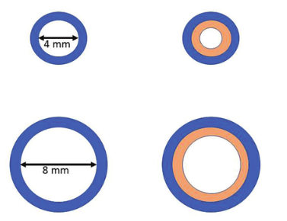
Quick facts
Full name? Respiratory syncytial virus
What? A common infection of the nose, throat, lungs. It disrupts the lining of the airway. This, along with inflammation and mucus, narrows the airway, making it hard for an infected infant to breathe.
Infant airway
Adult airway
Resistance increases
16 times
3 times
https://www.researchgate.net/figure/The-effect-of-airway-narrowing-in-adult-and-neonate-ariways_fig1_377320100

Slide 10
Quick facts (continued)
When? Usually begins in the fall, continues through winter and into early spring
Where? Worldwide
Treatment? There is no specific treatment for RSV. An infant may need extra oxygen or I.V. fluids while the airway recovers

Slide 11

Let’s play “Test the Moderator!” True or False?
Among infants infected with RSV for the 1st time 20 to 30% develop
lower tract disease such as bronchiolitis or pneumonia.
Before RSV infection prevention was available, about 1/1,000 (0.1%) children in the U.S. were hospitalized for RSV in the 1st year of life.
Humans are the only source of RSV infection.
RSV can only be transmitted during the symptomatic phase.
If a child is infected with influenza, he cannot ALSO be infected with RSV.
No currently available treatment shortens the course of bronchiolitis or speeds the disappearance of symptoms.
Notes:
Most infants infected with RSV for the first time develop upper respiratory tract symptoms and 20 to 30% develop lower tract disease such as bronchiolitis or pneumonia. This is a huge problem because almost all children are infected by RSV in the 1st 24 months of life.
Before RSV infection prevention was available, approximately 1 to 3% of all children in the U.S. were hospitalized for RSV in the 1st 12 months of life.
Humans are the only source of RSV infection.
RSV can be transmitted before, during, and after the symptomatic phase.
As many as 30% of symptomatic children will be co-infected with two or more respiratory viruses.
No currently available treatment shortens the course of bronchiolitis or speeds the disappearance of symptoms. Neither antimicrobials, corticosteroids, nor albuterol are recommended.

Slide 12
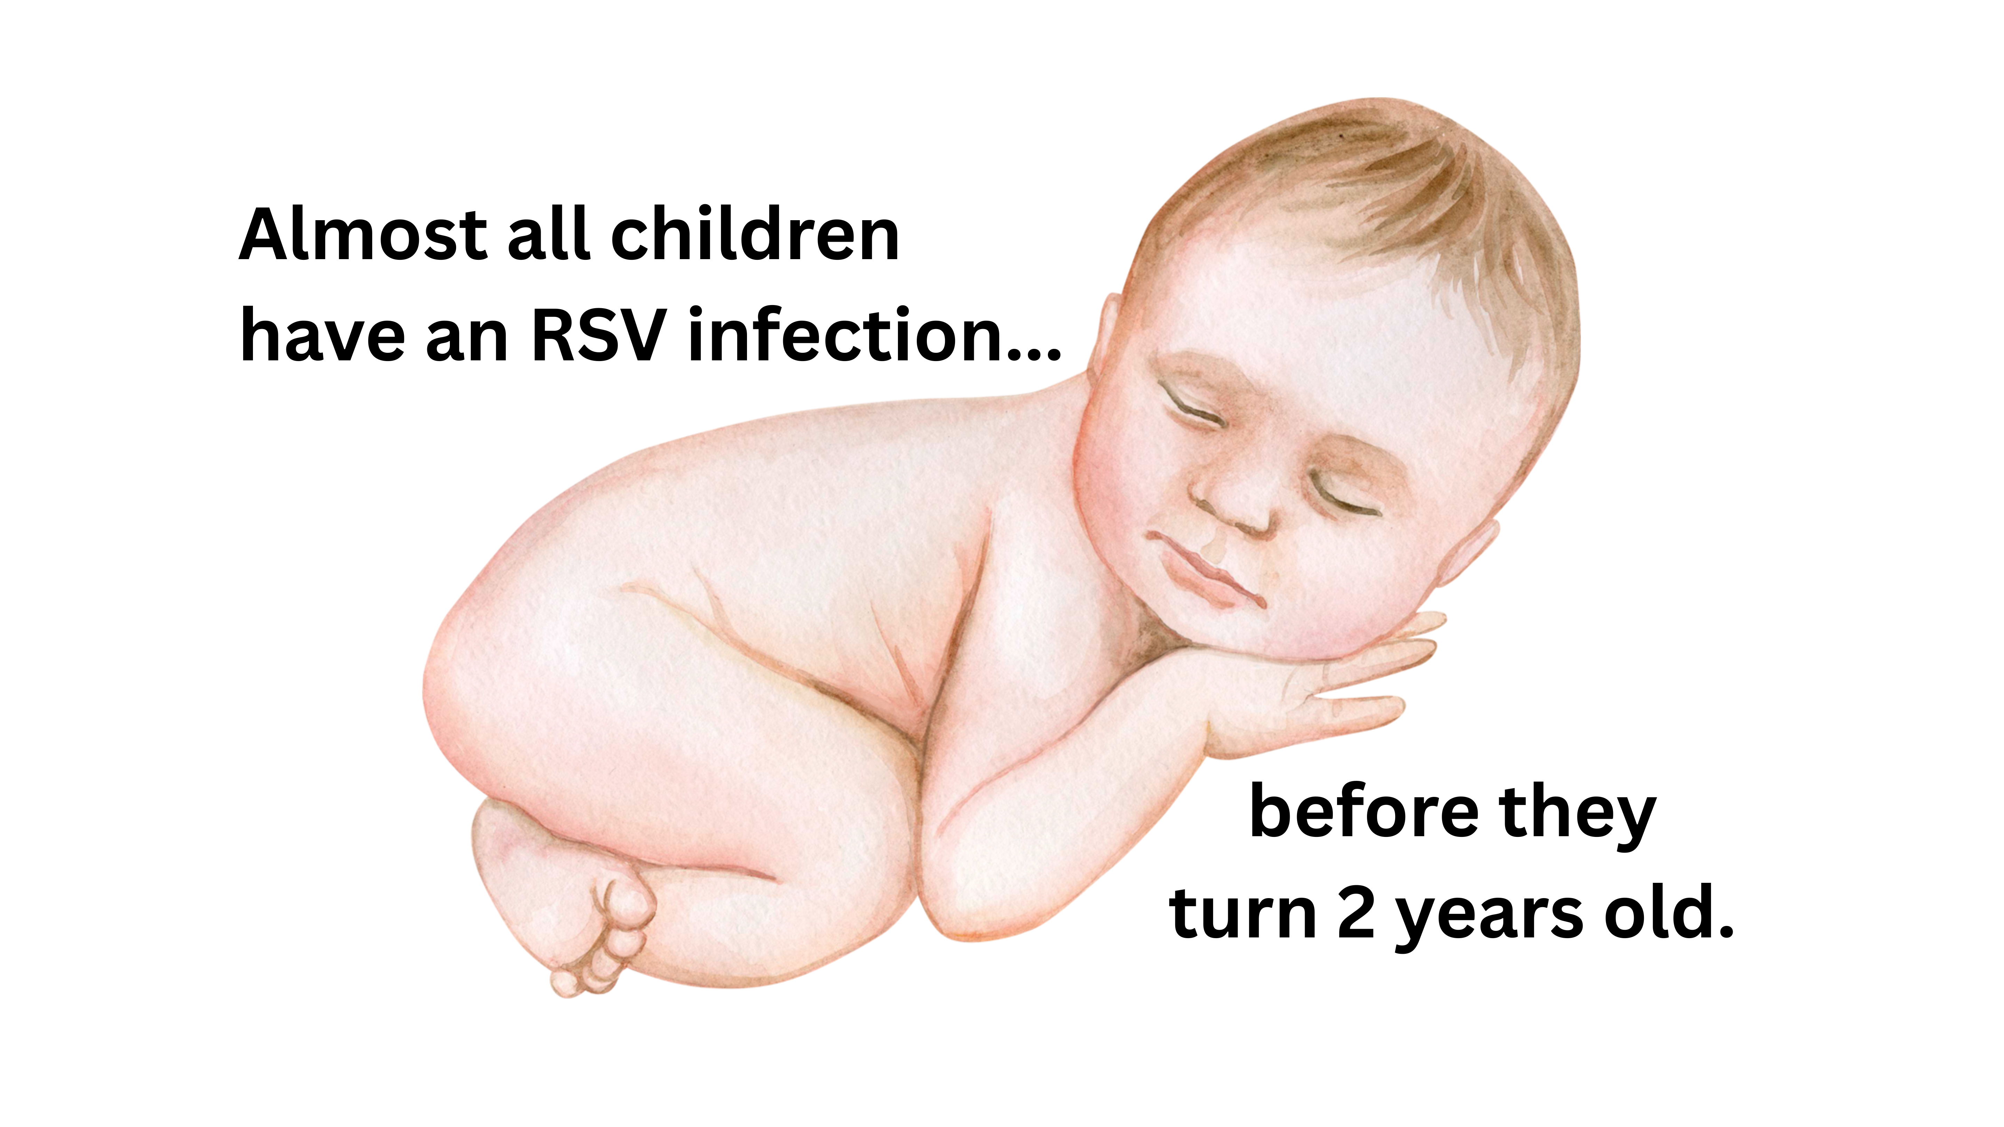
Who?
https://pmc.ncbi.nlm.nih.gov/articles/PMC3258650/
Notes:
RSV spreads easily so many people get infected.
Risk factors increasing the risk of RSV acquisition of RSV include: birth before and/or during RSV season, day care attendance, presence of older siblings in school or day-care, and lack of breast feeding. Reference

Slide 13
Which children are at greatest risk from RSV?
RSV infection is a VERY big problem for these groups of young children:
Premature infants
Infants up to age 12 months, esp. those <6 months
Children <2 years with chronic lung or heart disease
Children with weakened immune systems
Children with conditions that make it difficult for them to
  Swallow
  Clear mucus
https://pmc.ncbi.nlm.nih.gov/articles/PMC3258650/
Notes:
RSV infections are usually mild and most people do get better in 7-14 days. However, infants often get seriously ill and most of the infants hospitalized for RSV were completely healthy before the infection.
RSV infection is a VERY big problem for these groups of young children:
Premature infants
Infants up to age 12 months, especially those 6 months and younger
Children less than age 2 years with chronic lung or heart disease
Children with weakened immune systems
Children with conditions that make it difficult for them to swallow or clear mucus
For more on this, see this article.

Slide 14
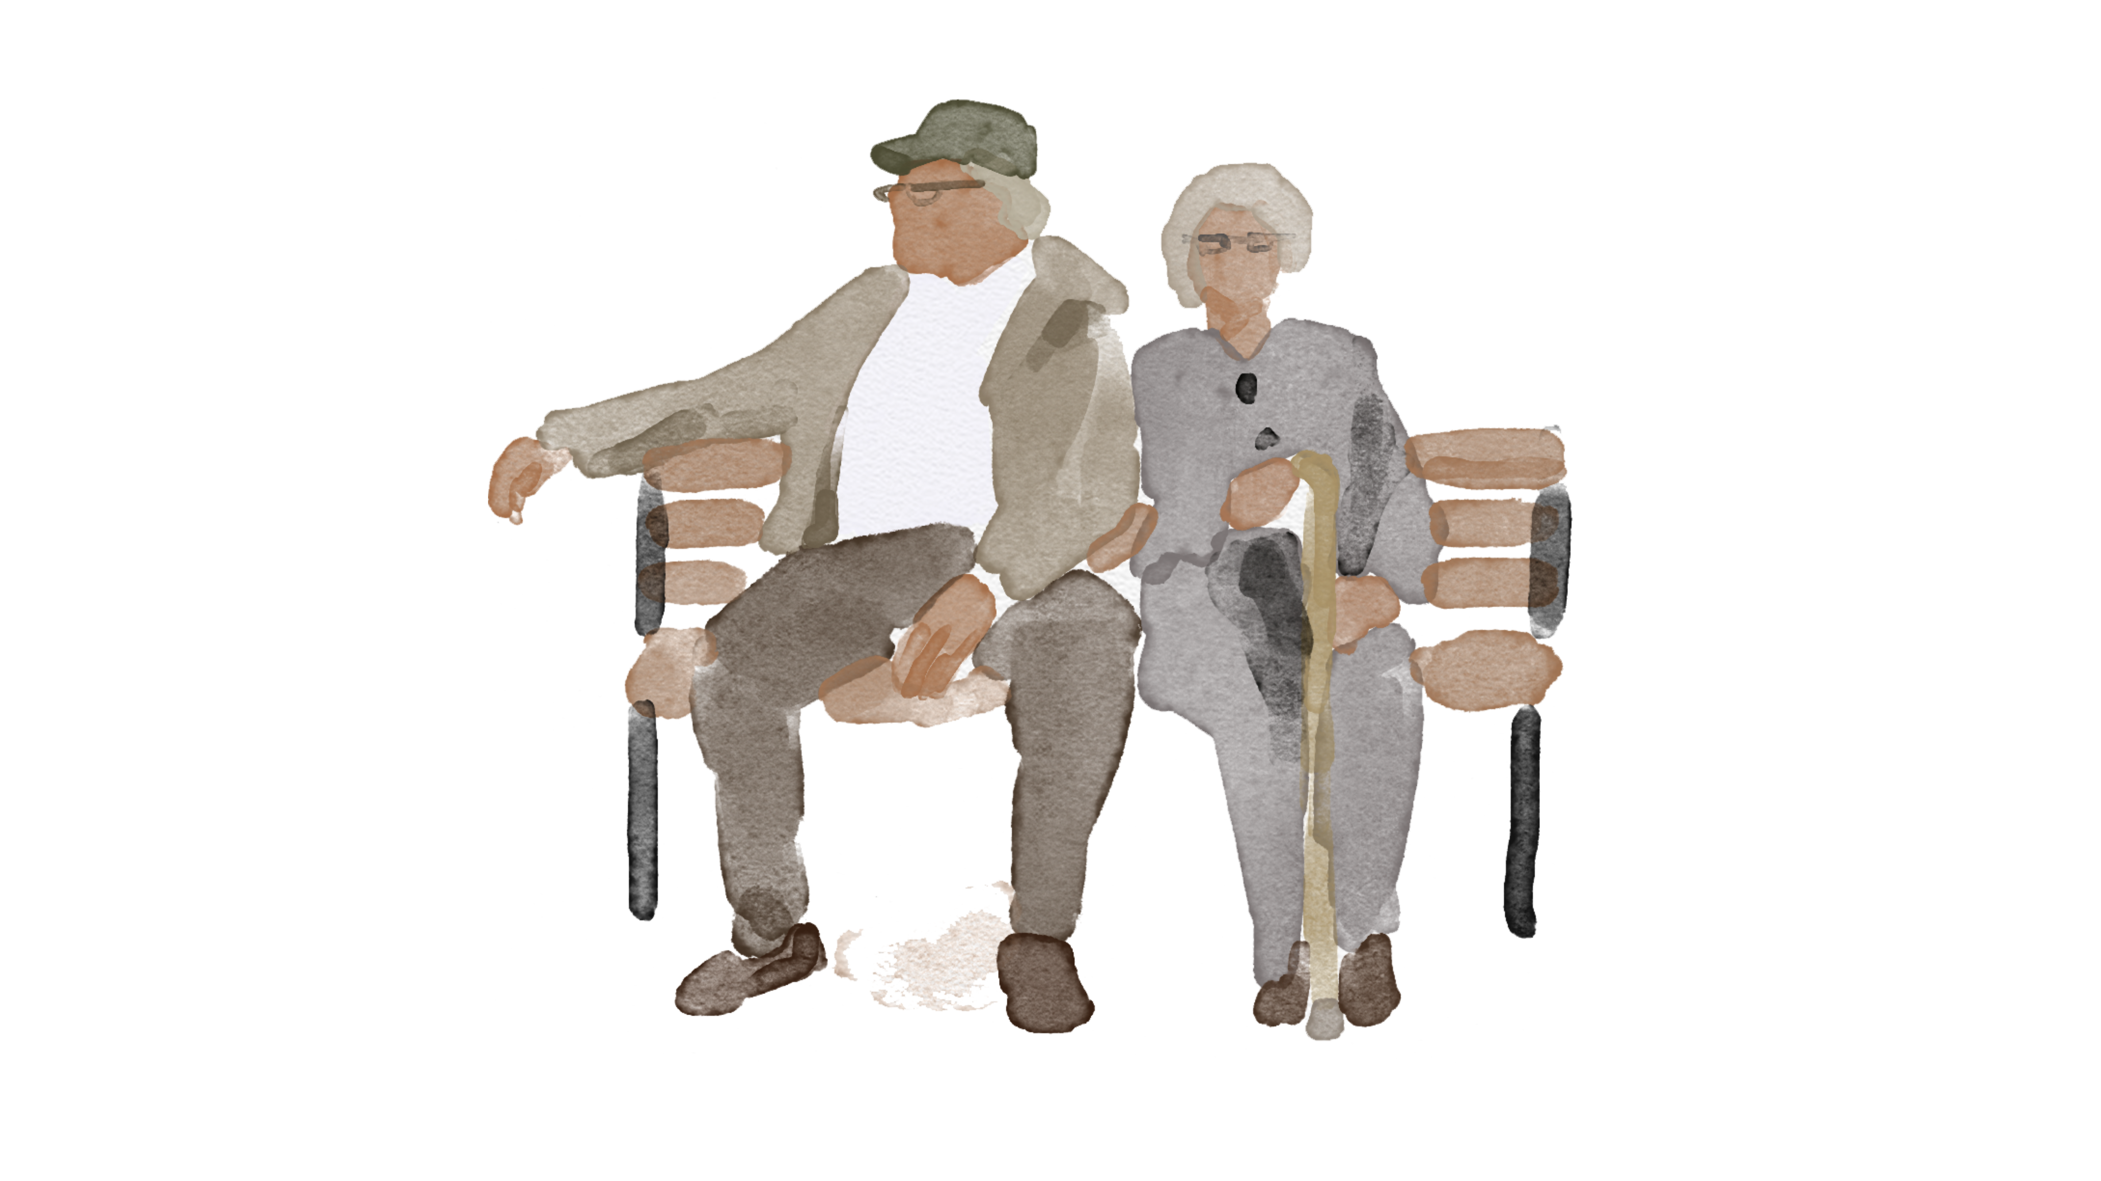
Adults: In the U.S., each year people age 65 & older bear the following outcomes from RSV disease
2,200,000 symptomatic illnesses
177,000 hospitalizations
14,000 deaths
https://publications.aap.org/redbook/book/755/Red-Book-2024-2027-Report-of-the-Committee-on?autologincheck=redirected%E2%80%8B

Slide 15
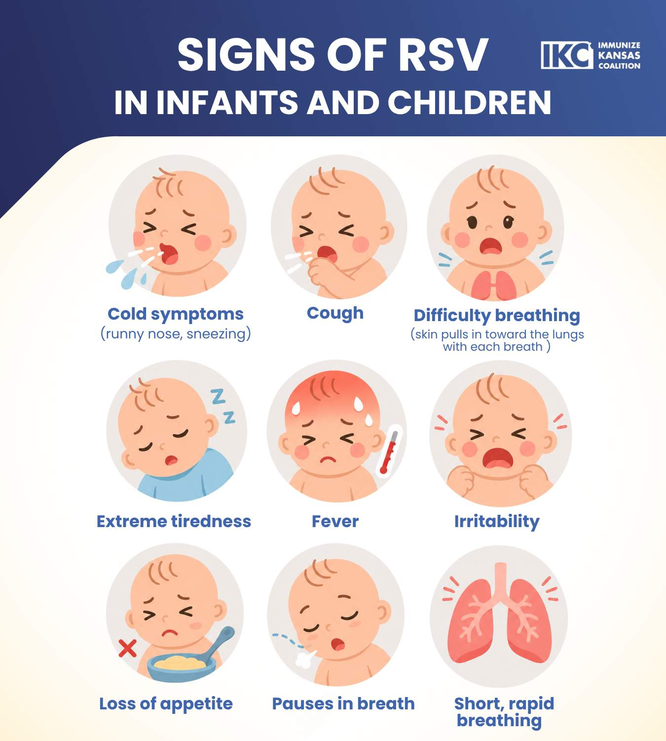
Notes:
When RSV disease progresses to the lower respiratory tract, symptoms may progress to include increased respiratory effort with tachypnea, wheezing, rales, intercostal and/or subcostal retractions, and nasal flaring. Because of the lung inflammation, some children have low oxygen levels in the blood.
RSV infection symptoms during the first weeks of life (especially among premature infants) may be non-specific: lethargy, irritability, and decreased activity, eating, & drinking.
Some infants, even those who did not have respiratory distress, develop apnea (pauses in breathing for more than 10 seconds).

Slide 16
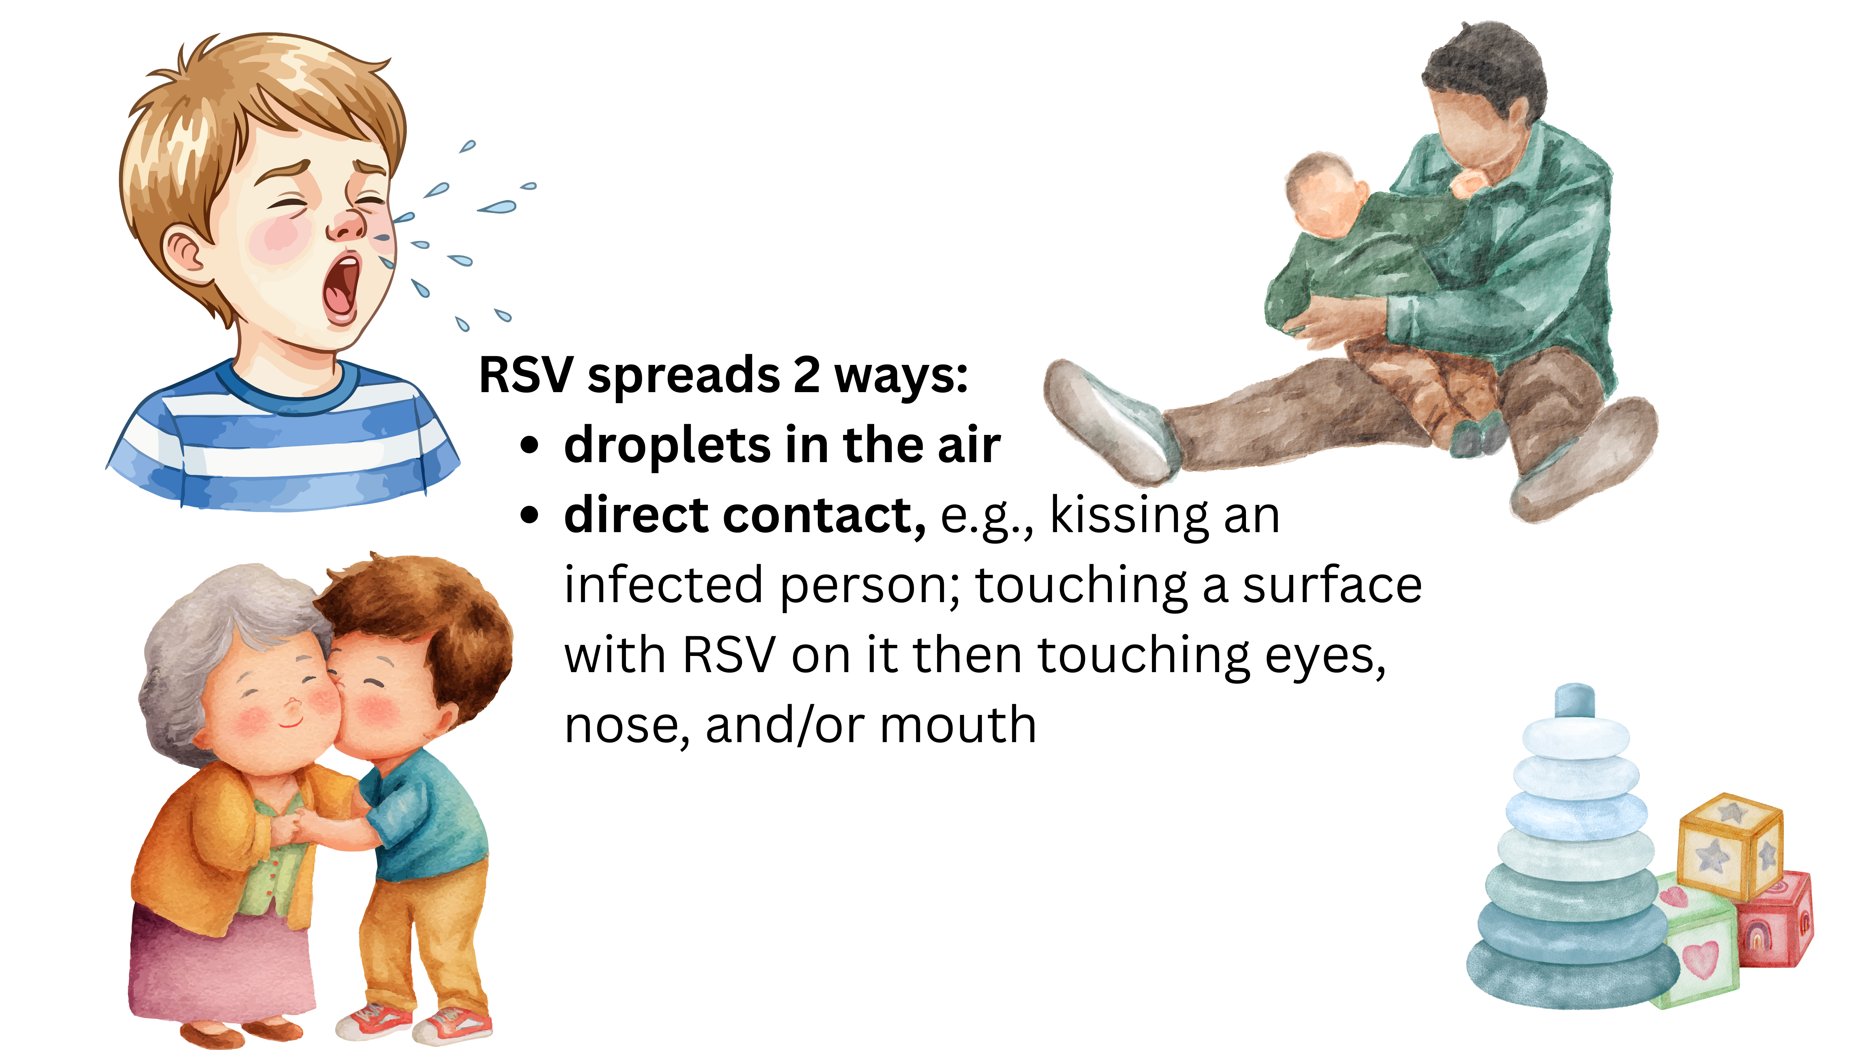
RSV Spread
Each year, among young children in the U.S., before prevention was available,
RSV disease led to >2 million visits to a healthcare provider and 80,000 hospital stays.
Notes:
RSV transmission occurs in two ways:
Through respiratory droplets at short distances (usually less than 6 feet)
By touching contaminated surfaces. RSV can persist on environmental surfaces for several hours and -- even on hands --for 30 minutes or more.

Slide 17
Outline of today’s 30-minute infant RSV webinar
Why is RSV a big deal for infants?
How to prevent infant RSV disease
RSV preventive monoclonal antibody for infants
RSV vaccine for use during pregnancy
Wrap up
Additional resources

Slide 18
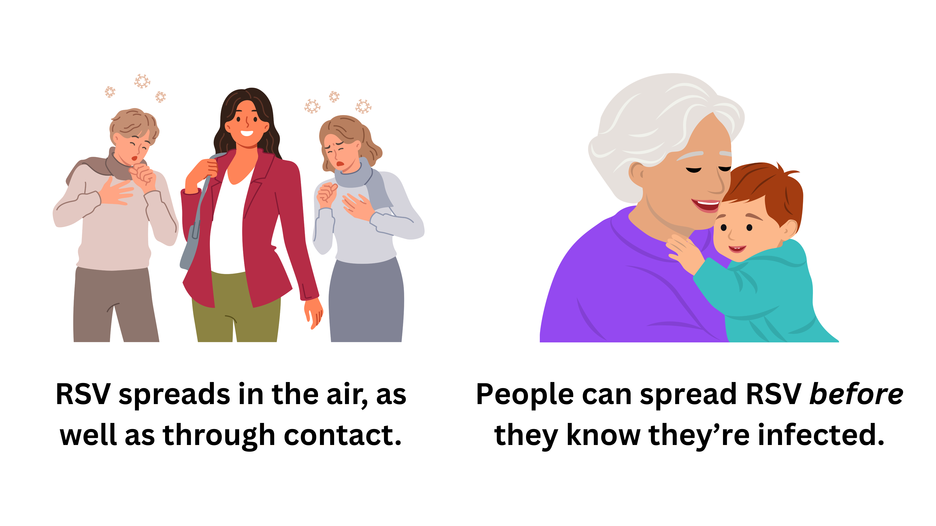
Why common methods are not very effective for RSV
(e.g., hand washing, stay home when ill)
Notes:
The common ways of preventing infant infection are worthwhile (for example, frequent hand washing, limiting crowds & sick contacts, and sanitizing surfaces). Unfortunately, these are not very effective at preventing RSV infection.
Here are two main reasons: (1) RSV spreads in the air and (2) people can spread RSV before they know they're infected.

Slide 19
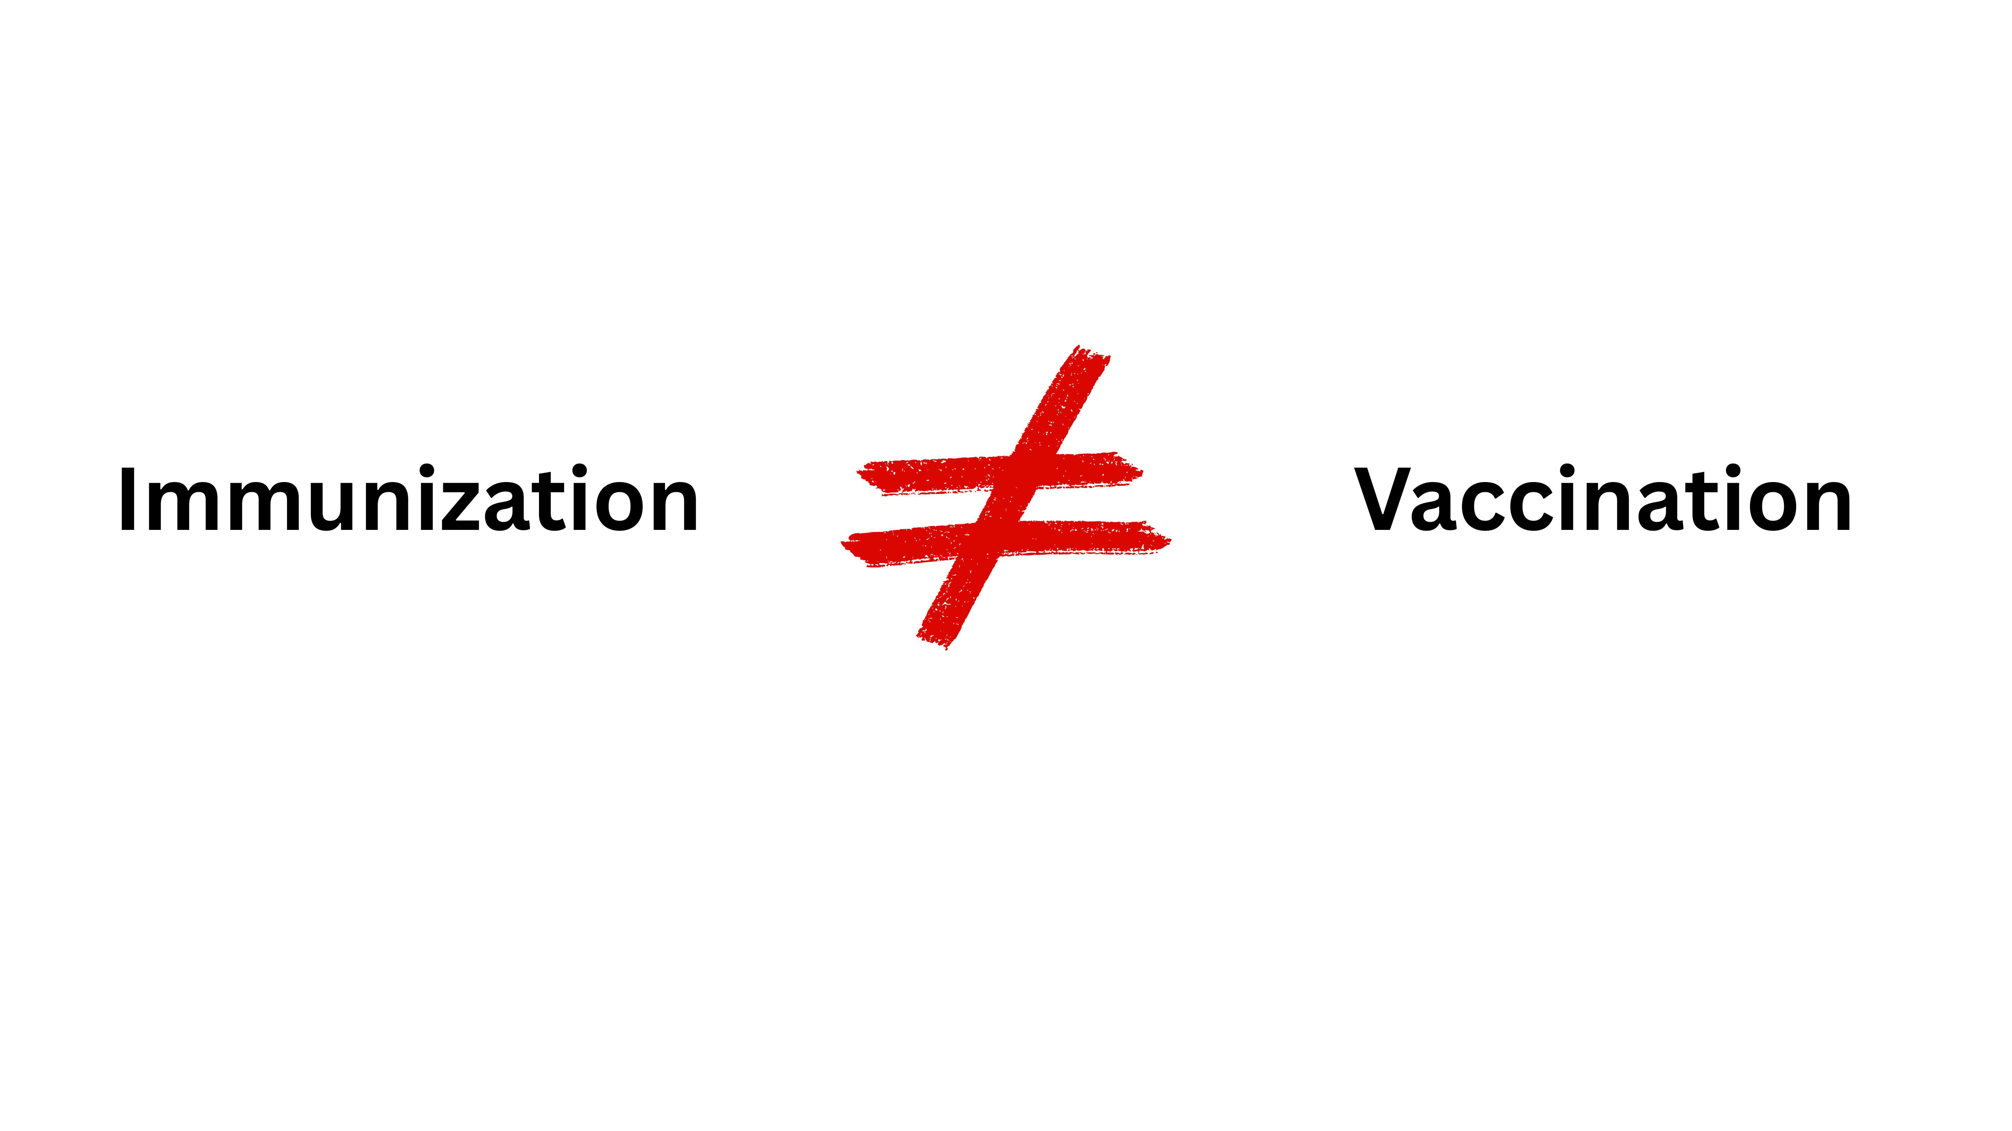
Immunization is very effective
In 2023, three advances in RSV prevention became available.
RSV preventive monoclonal antibody (mAb)
RSV vaccine for use during pregnancy to protect the newborn
RSV vaccine for adults

Slide 20
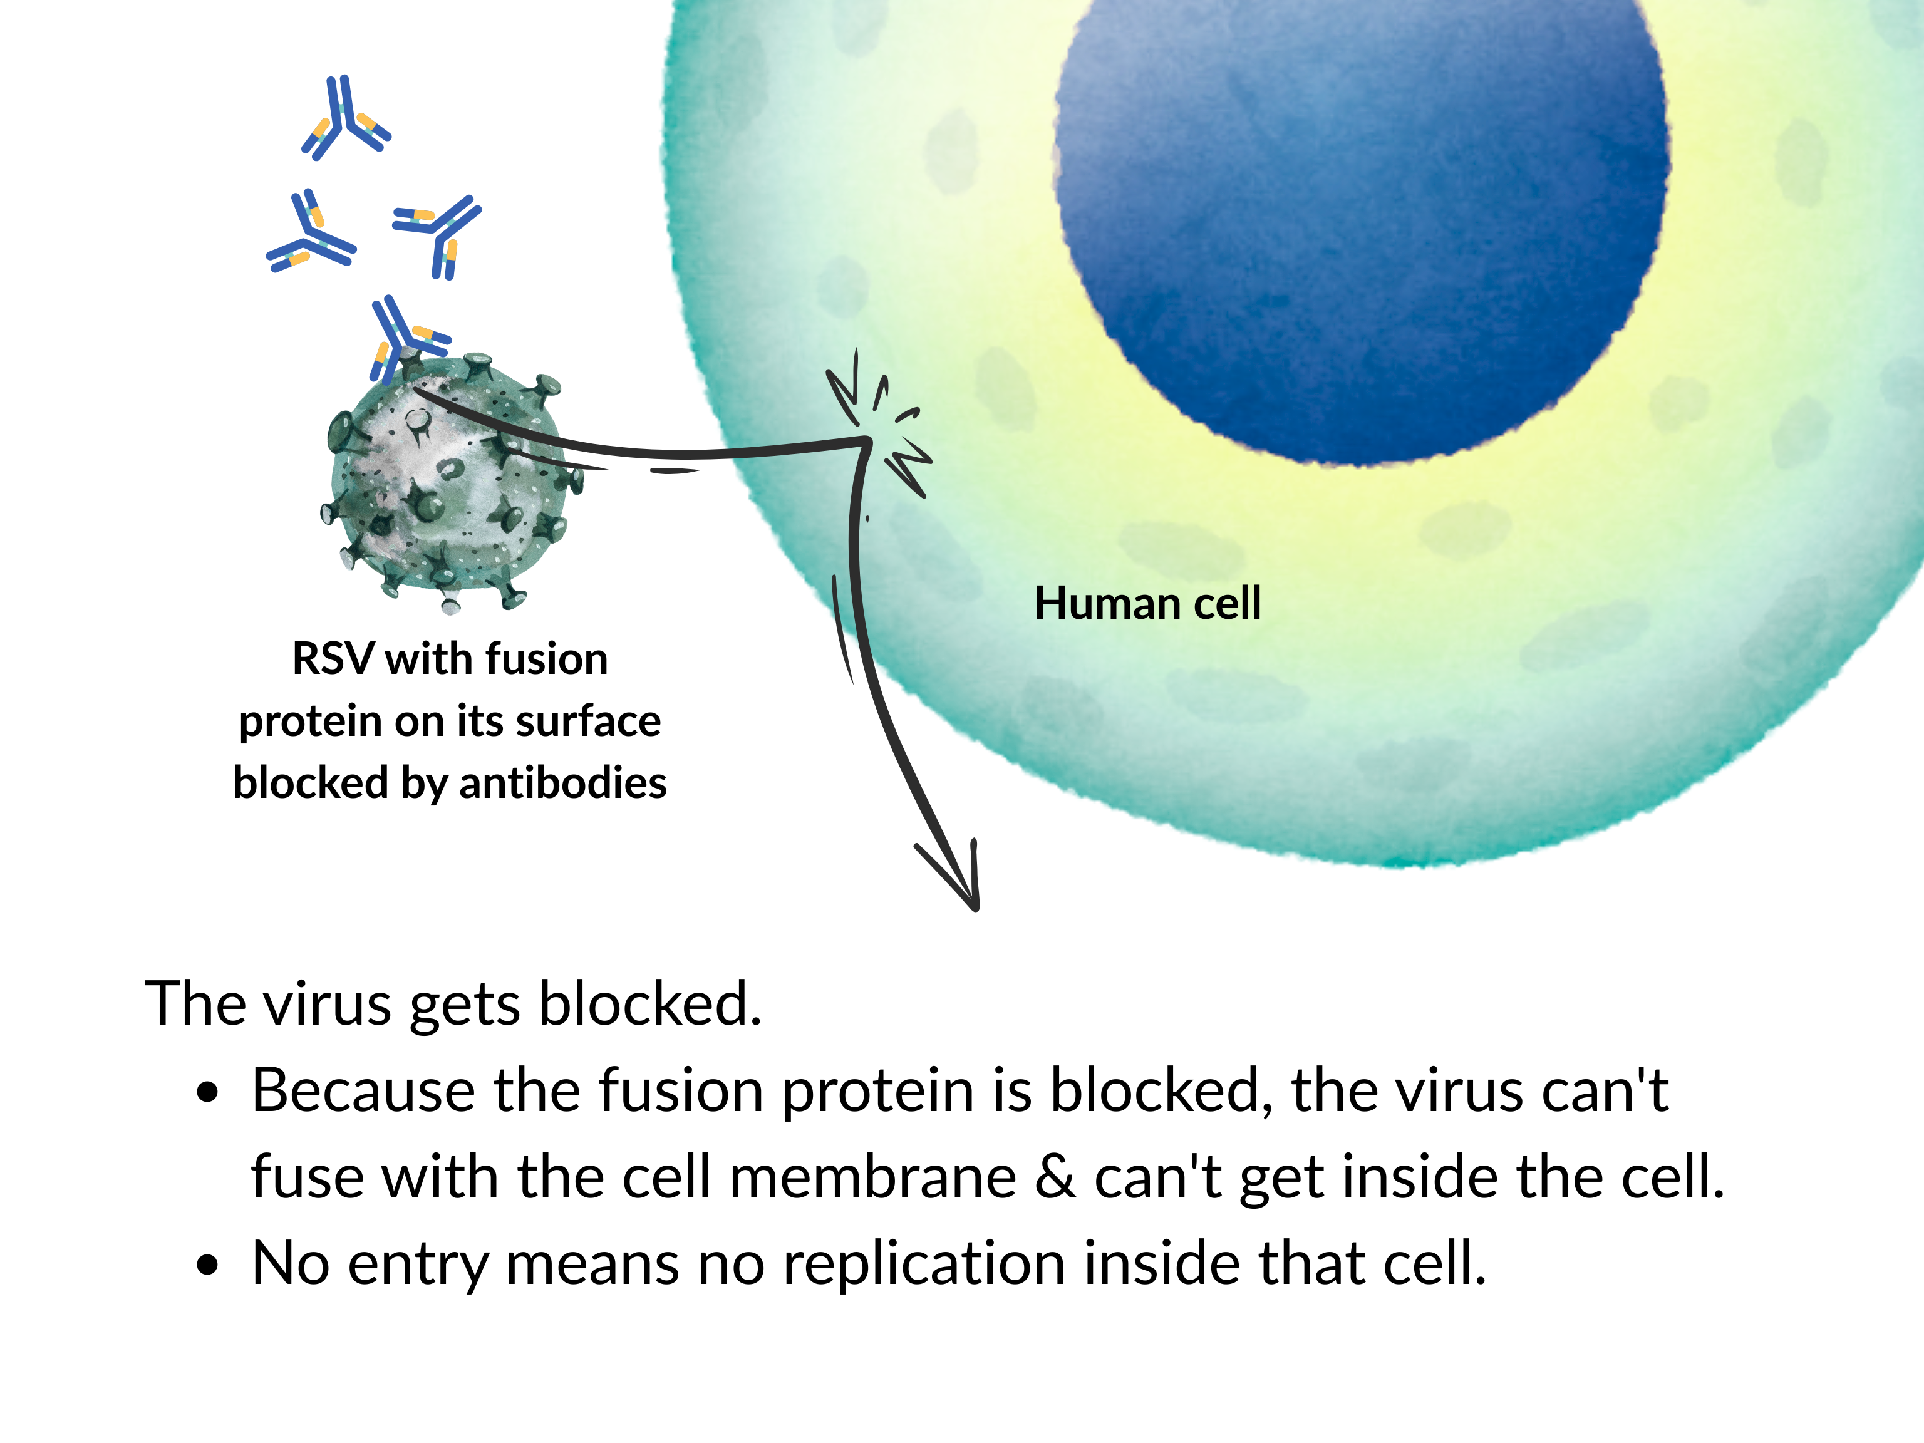
Both maternal vaccination and infant immunization depend on RSV-specific antibodies doing two things:
Blocking the RSV virus from getting into the cell AND
Alerting other immune cells to remove the virus
Notes:
Imagine it this way
The human cell is like a home that the virus is trying to break into using its "key" -- the fusion protein on its surface.
The antibody is like a cap that gets glued onto the key, so the key doesn't work anymore! Also, the antibody alerts the authorities (immune cells) to come and get rid of the virus.
In short: RSV antibodies prevent infection by attaching to the virus's fusion protein. This stops the virus from entering and infecting airway cells.

Slide 21
Outline of today’s 30-minute infant RSV webinar
Why is RSV a big deal for infants?
How to prevent infant RSV disease
RSV preventive monoclonal antibody for infants
RSV vaccine for use during pregnancy
Wrap up
Additional resources

Slide 22
RSV preventive monoclonal antibody for infants
The 1998 monthly RSV mAb (Palivizumab, Synagis) is no longer in use
Long-acting RSV mAbs: Nirsevimab (Beyfortus, Sanofi), clesrovimab (Enflonsia, Merck)
  Laboratory-made antibodies, to be given before exposure to RSV.
  Monoclonal
  Other mAbs are used to treat autoimmune diseases, cancer, other infections, & more
When? Quick onset of action. The timing for the injection varies by state. In KS, usually October through March.
How long do they last? A dose can protect infants for 5 months
(the entire average RSV season)
Notes:
Full name? Nirsevimab (Beyfortus, Sanofi) or clesrovimab (Enflonsia, Merck)
What?
They are laboratory-made antibodies, to be given before exposure to RSV.
They are called "monoclonal," meaning that the products are only RSV antibodies. Antibodies against other viruses are NOT included.
Other monoclonal antibodies are used to treat autoimmune diseases, cancer, other infections, and much more.
When? These start to work as soon as they're injected. Because the RSV season is different in some states and in some years, the exact timing for the injection can vary. In most states and in most years, these antibodies are given from October through March.
How long do they last? One dose can protect infants for 5 months. This is the length of an average RSV season.

Slide 23

Who should be immunized?

Slide 24
1) Infants younger than 8 months & 0 days
Infants younger than 8 months & 0 days who are born during or are entering their 1st RSV season should all receive a dose of mAb UNLESS the mother is certain she was properly vaccinated against RSV during the pregnancy.
"Properly vaccinated"
  the right RSV vaccine (Abrysvo)
  during the right phase of pregnancy (32-36 weeks of gestation), and
  the infant was born at least 14 days after she received the vaccine
If the vaccination status during pregnancy is unknown, the infant should get the RSV antibody.

Slide 25
Circumstances when infant should get RSV mAb despite properly vaccinated mother
Infants born to mothers who have a health condition that might:
  Prevent an adequate maternal immune response to vaccination
  (e.g., immunocompromising condition caused by disease or immunosuppressive treatment)
  Reduce transplacental antibody transfer
  (e.g., mother living with HIV infection)
Infants who might have lost maternal antibodies (e.g., ECMO)
Infants with substantially increased risk for severe RSV disease
(e.g., hemodynamically significant congenital heart disease or ICU admission requiring oxygen at hospital discharge)
See Immunize.org's "Ask the Experts" web page on RSV

Slide 26
2) Children 8-19 months old
Children age 8 through 19 months who are at increased risk for severe RSV disease AND are entering their 2nd RSV season are recommended to receive nirsevimab (Beyfortus) (not clesrovimab) regardless of history of maternal vaccination:
Have severe immune compromise
Have chronic lung disease of prematurity
Have severe cystic fibrosis
Are American Indian or Alaska Native children (esp. important for those who are in remote communities)
Vaccine Education Center at Children's Hospital of Philadelphia

Slide 27
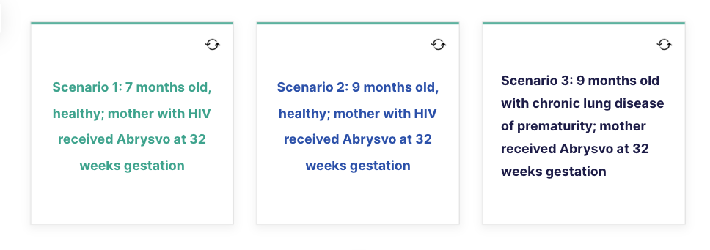
Quiz: Decide if the child, who is coming into RSV season, needs a dose of mAb.
Notes:
mAb needed for #1 and #3
The infant in #2 is too old for routine 1st season dose and does not meet criteria for 2nd season dose

Slide 28
Quiz: Decide if the child, who is coming into RSV season, needs a dose of mAb.
Yes, needs mAb.
HIV may reduce transplacental Ab passage
Notes:
mAb needed for #1 and #3
The infant in #2 is too old for routine 1st season dose and does not meet criteria for 2nd season dose

Slide 29
Quiz: Decide if the child, who is coming into RSV season, needs a dose of mAb.
Notes:
mAb needed for #1 and #3
The infant in #2 is too old for routine 1st season dose and does not meet criteria for 2nd season dose

Slide 30
Quiz: Decide if the child, who is coming into RSV season, needs a dose of mAb.
No, does not need mAb. Infant is too old for routine RSV immz
Notes:
mAb needed for #1 and #3
The infant in #2 is too old for routine 1st season dose and does not meet criteria for 2nd season dose

Slide 31
Quiz: Decide if the child, who is coming into RSV season, needs a dose of mAb.
Notes:
mAb needed for #1 and #3
The infant in #2 is too old for routine 1st season dose and does not meet criteria for 2nd season dose

Slide 32
Quiz: Decide if the child, who is coming into RSV season, needs a dose of mAb.
Yes, needs mAb.
9-18 months old with chronic lung disease of prematurity
Notes:
mAb needed for #1 and #3
The infant in #2 is too old for routine 1st season dose and does not meet criteria for 2nd season dose

Slide 33
Safety of RSV mAb
Side effects after getting an RSV mAb are rare. They may include:
Reactions where the injection was given (red, tender, swollen)
Mild rash in less than 1 in 100 (<1%)
For more details on this, see
https://www.immunize.org/ask-experts/what-are-the-side-effects-of-rsv-preventive-antibody-products/

Slide 34

Effectiveness of RSV mAb
RSV mAb can reduce the risk of serious lower lung infections in infants by about 80%.
They are 80-90% effective at protecting infants in their first RSV season from needing a hospital stay due to RSV.
See this video: https://www.youtube.com/watch?v=iq97xtzGO4k

Slide 35
Other notes about mAb
Insurance coverage
RSV mAb at the same visit with other vaccines

Slide 36
Outline of today’s 30-minute infant RSV webinar
Why is RSV a big deal for infants?
How to prevent infant RSV disease
RSV preventive monoclonal antibody for infants
RSV vaccine for use during pregnancy
Wrap up
Additional resources
Notes:
Another way to get antibodies specific for RSV into an infant's bloodstream is by vaccinating the mother during pregnancy. Then, during the pregnancy, the RSV antibodies that she develops will pass to the unborn infant through the placenta.
There are three, FDA-licensed RSV vaccines available in the U.S. but only one is licensed for used during pregnancy.

Slide 37
Maternal vaccination with Abrysvo
What? Protein-based vaccine designed to prevent serious RSV disease in infants younger than age 6 months.
When?
  Season: In much of the U.S. -- including Kansas -- maternal vaccination occurs from September 1 through January 31.
  Gestation: Maternal vaccination is recommended during ONE pregnancy only, between 32 weeks and 36 weeks 6 days of gestation.
  Delivery date: Infants born <14 days after the mother's vaccination are recommended to be immunized with an RSV mAb after birth.
Duration of immunity? If given properly, maternal antibodies protect the baby against RSV for about 6 months after birth.

Slide 38
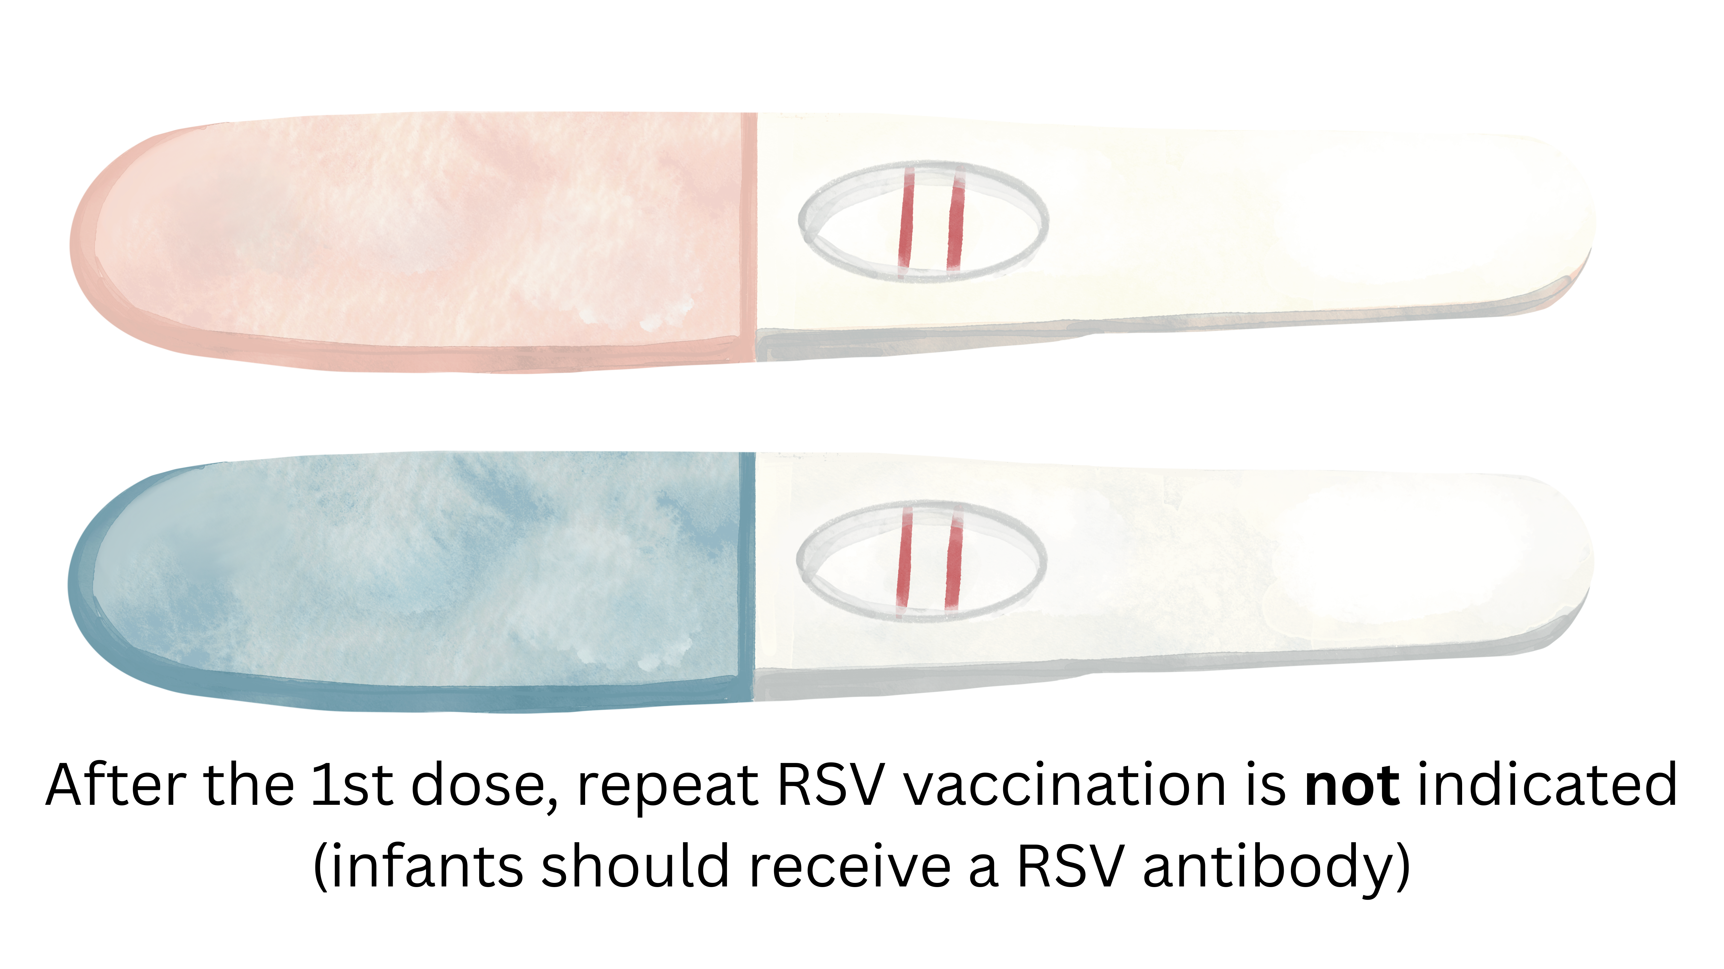
ACOG recommendation
ACOG recommends that eligible pregnant individuals who meet criteria (including time of year, number of weeks gestation, not previously vaccinated against RSV, etc.) should receive the RSV vaccine.
ACOG 2026 immunization schedule available here

Slide 39
Safety of maternal vaccination with Abrysvo
Most commonly reported side effects by pregnant individuals who received the RSV vaccine: Pain at the injection site, headache, muscle pain, nausea
Inconclusive: The evidence on RSV vaccine association with an increase in hypertensive disorders of pregnancy is inconclusive
An increase in GBS has not been seen in pregnancy, but in January 2025, the FDA required safety labeling changes to the Prescribing Information for Abrysvo
https://www.acog.org/clinical/clinical-guidance/practice-advisory/articles/2023/09/maternal-respiratory-syncytial-virus-vaccination

Slide 40
Effectiveness of maternal vaccination
A study published in 2025 found that among newborns & infants
<6 months of age, maternal RSV vaccine effectiveness was:
  64% against any medically attended
  RSV-associated acute respiratory infection
  70% against RSV-associated hospitalization
https://jamanetwork.com/journals/jamapediatrics/article-abstract/2843213

Slide 41
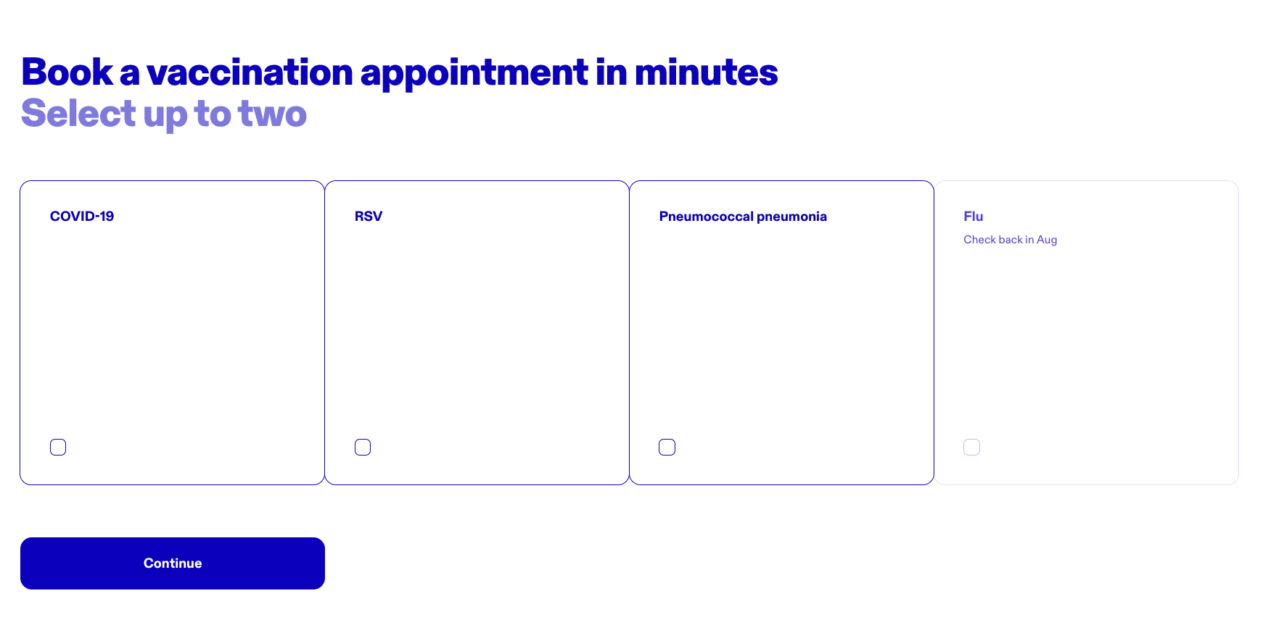
Where can I find Abrysvo?
  To find pharmacies that have Abrysvo:
  www.abrysvo.com/find-a-vaccine or
  vaxassist.com

Slide 42
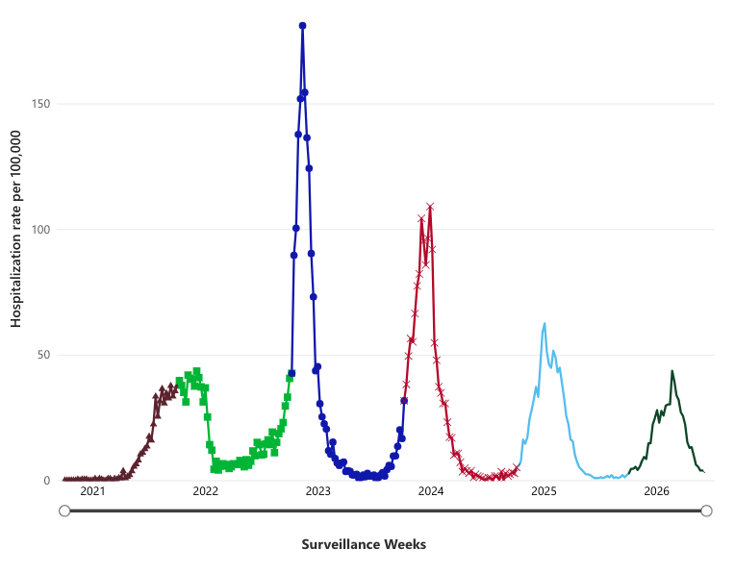
RSV-Associated Hospitalization, age <1 yr
https://www.cdc.gov/rsv/php/surveillance/rsv-net.html
Notes:
During the COVID-19 epidemic, schools and daycare centers were closed and people took precautions to prevent the spread of respiratory disease. RSV rates were very low. When the world returned to normal, RSV again spiked.
Since 2023, when preventive measures became available, the rate of RSV-associated hospitalizations among infants (age less than 1 year) has trended downward as shown below. Is this just an uncanny coincidence or are the preventive measures working?
FROM JAMA PEDIATRICS: Based on a test-negative case-control analysis, nirsevimab effectiveness was 81% and maternal vaccine effectiveness was 70% against RSV hospitalizations. Using population-based surveillance data, RSV hospitalization rates in 2024-2025 were reduced by an estimated 41% to 51% among newborns and infants aged 0 to 11 months compared to 2017-2020 rates or estimated expected rates in 2024-2025; the highest reduction of 56% to 63% occurred in newborns and infants aged 0 to 2 months.
Meaning Pediatric RSV prevention products are effective and reduced the burden of RSV-associated hospitalizations in newborns and infants during 2024-2025.
https://jamanetwork.com/journals/jamapediatrics/article-abstract/2843213

Slide 43

Use of standing order templates www.immunize.org/clinical/topic/standing-orders-templates/?q=rsv
Clesrovimab
Nirsevimab
Abrysvo

Slide 44
Talking to families about the options
“Presumptive” or “announcement” approach
Ideally discussed during pregnancy
Tools to explain the options: See IKC parent handout

Slide 45
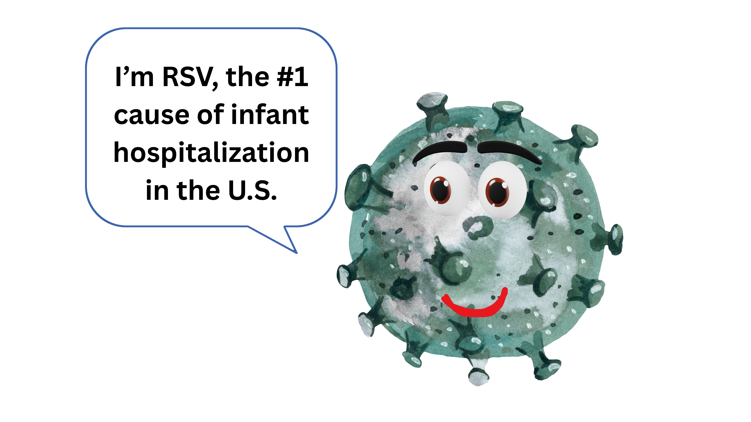
Wrap up
Why is RSV a big deal for infants?
How to prevent infant RSV disease
  RSV preventive monoclonal antibody for infants
    Routine for infants before 8 mo. Bday; select in 2nd season
    Safe, effective
  RSV vaccine for use during ONE pregnancy
    Good option if between 32 weeks & 36 weeks 6 days of gestation from Sept. to January
    Safe, effective
Use standing orders and an effective recommendation to optimize RSV prevention

Slide 46
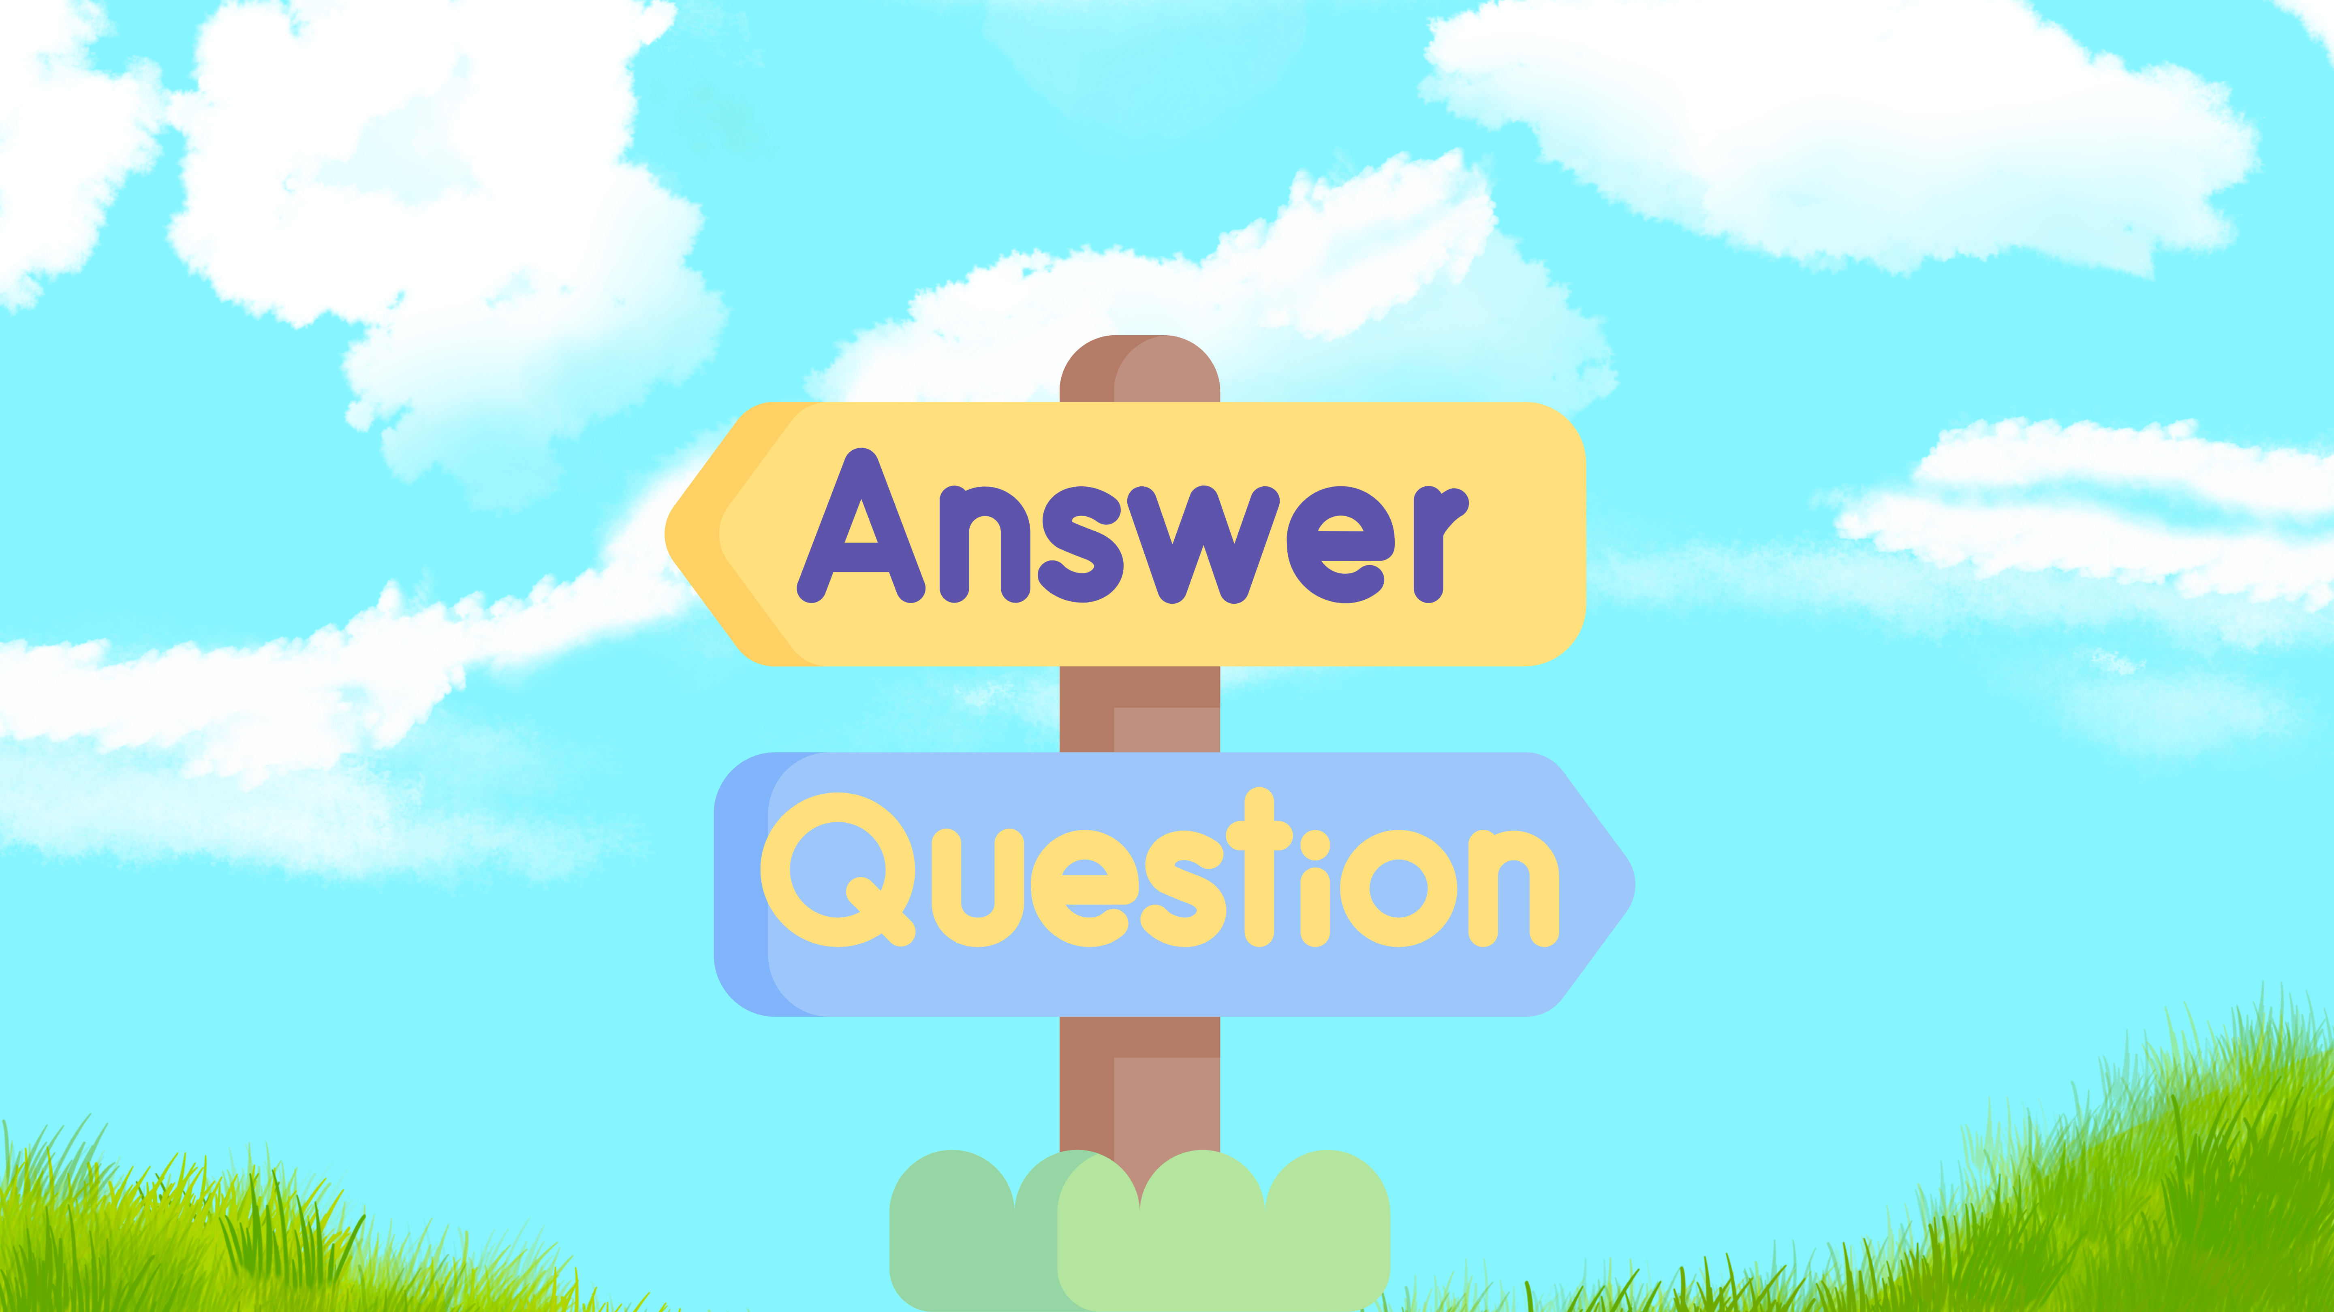
x
x

Slide 47
Credit Center
  To receive credit, please visit
  www.primeinc.org/credit and enter program code.
  Looking for the code?
  Live webinar: If you registered for and attended the live webinar but did have time to write down the code, please reach out to staff@immunizekansascoalition.org for assistance.
  Recorded webinar: We plan to post a recording of the webinar soon and hope to offer continuing education as enduring material. It will have a different code. Watch the website for more information.

